Slide 1
LOCAL CONVERSATION PREPARATION MATERIAL
Before the evening we would like you to either read / watch the following
SBGT ‘Why’ Video, either in video or written format.
The SBGT Timeline summary
The ‘Big Insights’ story
The Finance / Buildings update

Slide 2


Slide 3
Welcome
Technical host instructions
Conversations host

Slide 4
Worship
Faithful God, whose word is life:
come with saving power
to free our praise,
inspire our prayer
and shape our lives
for the kingdom of your Son,
Jesus Christ our Lord.
Amen.
Be with us, Spirit of God;
nothing can separate us from your love.
Breathe on us, breath of God;
fill us with your saving power.
Speak in us, wisdom of God;
bring strength, healing and peace.

Slide 5
Worship (Reading) Mark 2: 1-12
When he returned to Capernaum after some days, it was reported that he was at home.
² So many gathered around that there was no longer room for them, not even in front of the door; and he was speaking the word to them. ³ Then some people came, bringing to him a paralyzed man, carried by four of them. ⁴ And when they could not bring him to Jesus because of the crowd, they removed the roof above him; and after having dug through it, they let down the mat on which the paralytic lay.
⁵ When Jesus saw their faith, he said to the paralytic, “Son, your sins are forgiven.”
⁶ Now some of the scribes were sitting there, questioning in their hearts, ⁷ “Why does this fellow speak in this way? It is blasphemy! Who can forgive sins but God alone?”

Slide 6
Worship (Reading) Mark 2: 1-12
⁸ At once Jesus perceived in his spirit that they were discussing these questions among themselves; and he said to them, “Why do you raise such questions in your hearts?
⁹ Which is easier, to say to the paralytic, ‘Your sins are forgiven,’ or to say, ‘Stand up and take your mat and walk’?
¹⁰ But so that you may know that the Son of Man has authority on earth to forgive sins”—he said to the paralytic— ¹¹ “I say to you, stand up, take your mat and go to your home.”
¹² And he stood up, and immediately took the mat and went out before all of them; so that they were all amazed and glorified God, saying, “We have never seen anything like this!”

Slide 7
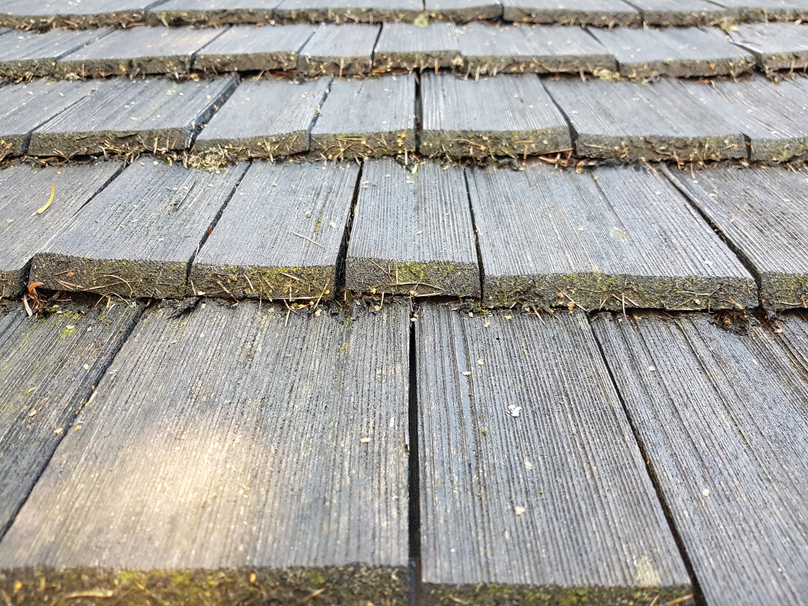
Question for reflection
How can we ‘remove the roof’ to let more people meet with Jesus?

Slide 8
The Lord’s Prayer
You may wish to use this video: Pentecost Service Lord’s Prayer 2020 on Vimeo
This can be download or viewed on Vimeo online – both via the link above

Slide 9


Slide 10
Why SBGT? – Quick recap of this video

Slide 11
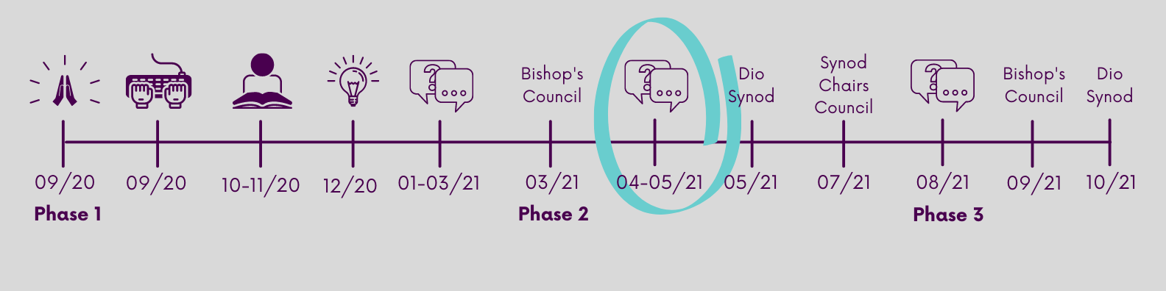
How SBGT – Timeline – recap on pre-reading

Slide 12
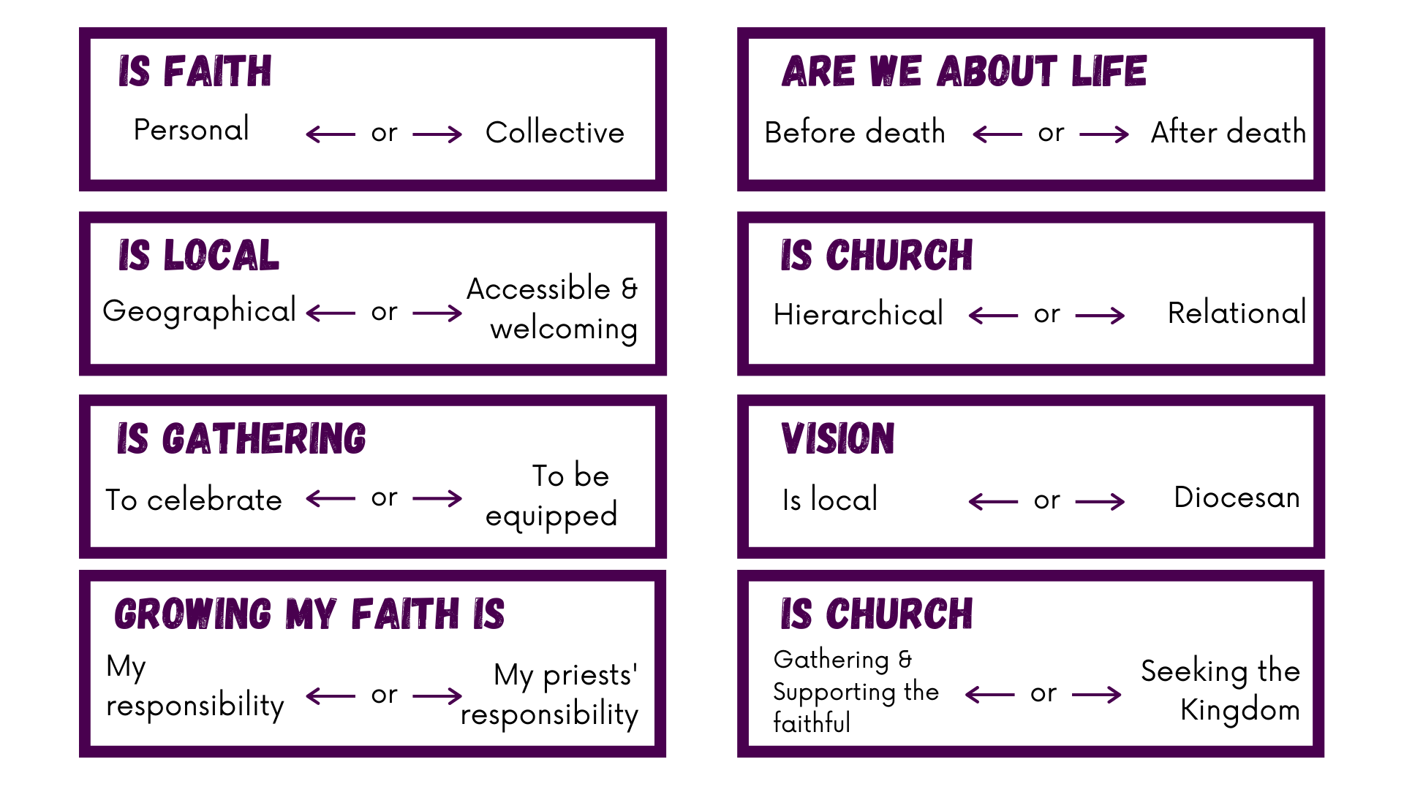
Insights
These insights arose from the SBGT story gathering.
They reveal something of our diversity as a diocese.
Which insight would most grab the attention of your church as you look to the future?

Slide 13
Introducing the 3 Ministry Models
Video can be viewed on YouTube here: https://youtu.be/bj2htFWZXQc
Video can be downloaded here
A transcript and screenshots can be downloaded here.

Slide 14
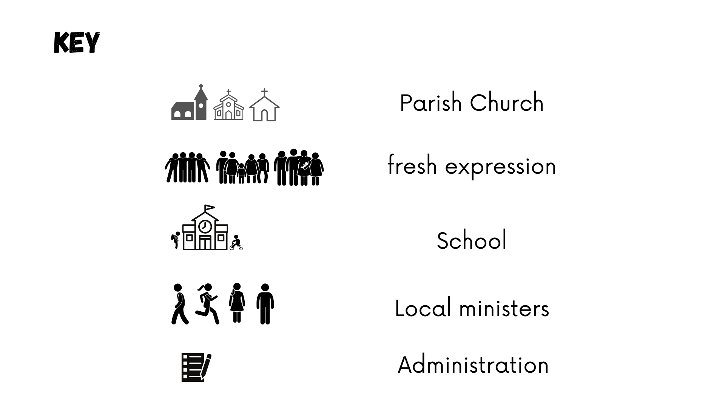
Models KEY

Slide 15
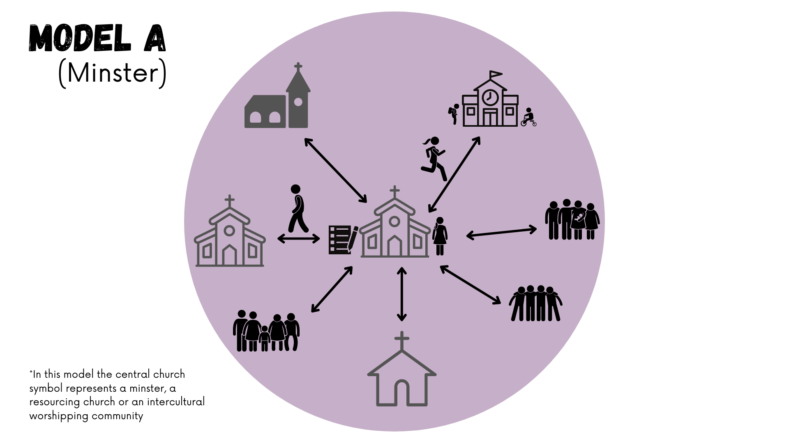
Model A

Slide 16
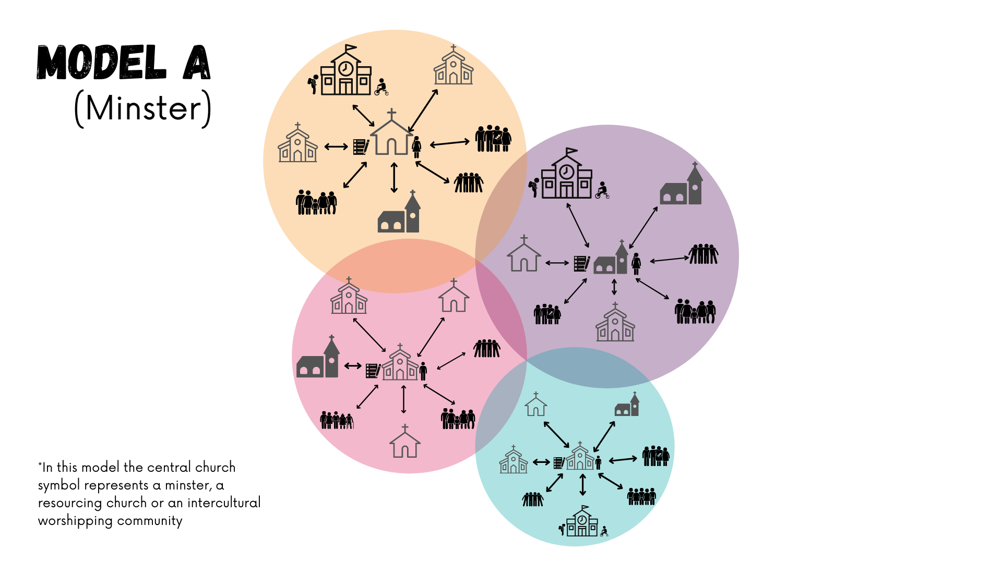
Model A

Slide 17
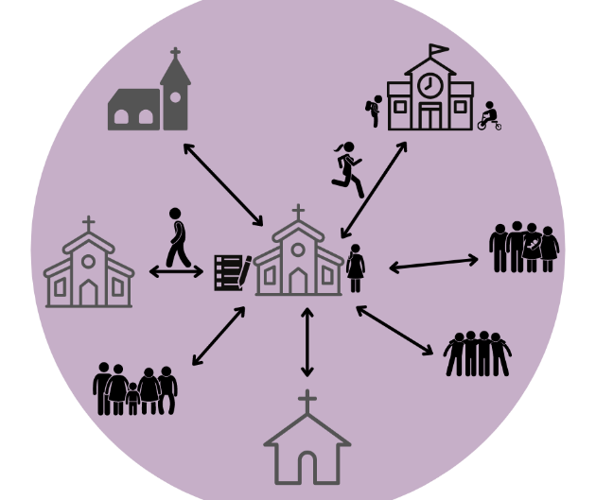
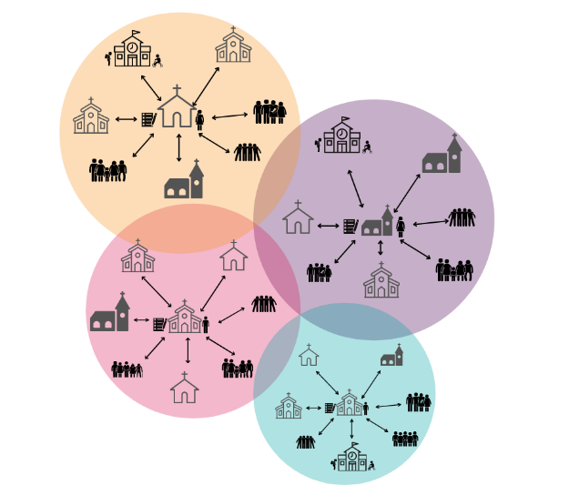
Model A
Examples:
We are a market town minster church serving town and villages
We are a resourcing church focussed on planting new communities of faith
We are a midweek urban minster with large youth engagement
We are a schools led minster,
We are an intergenerational worshipping community at heart…

Slide 18
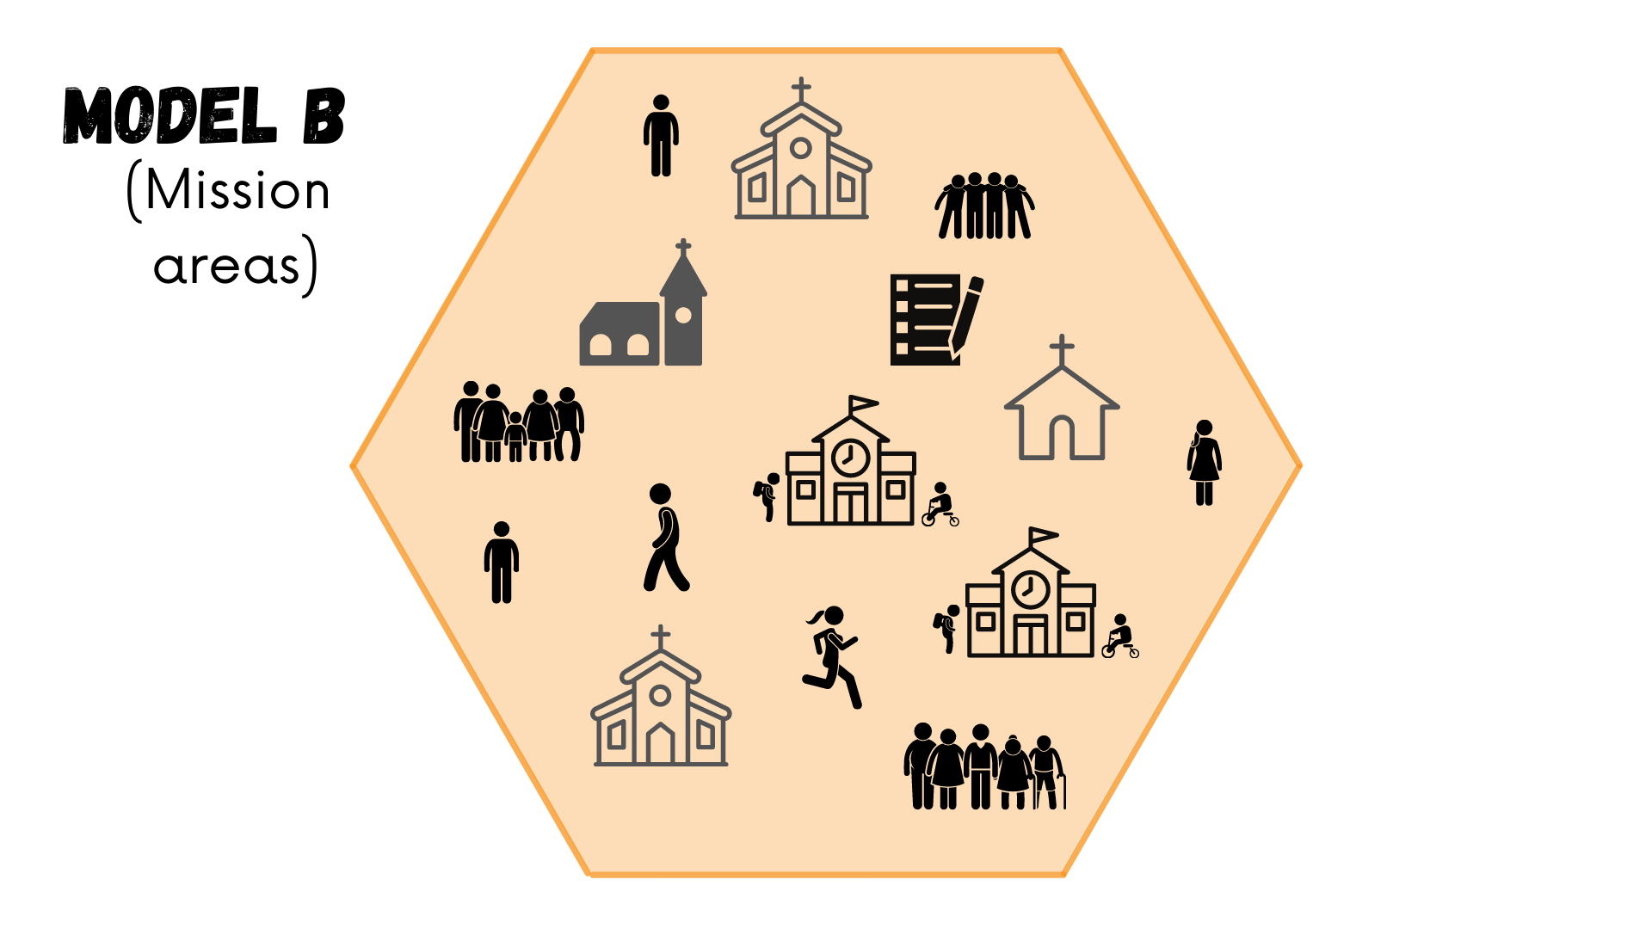
Model B

Slide 19
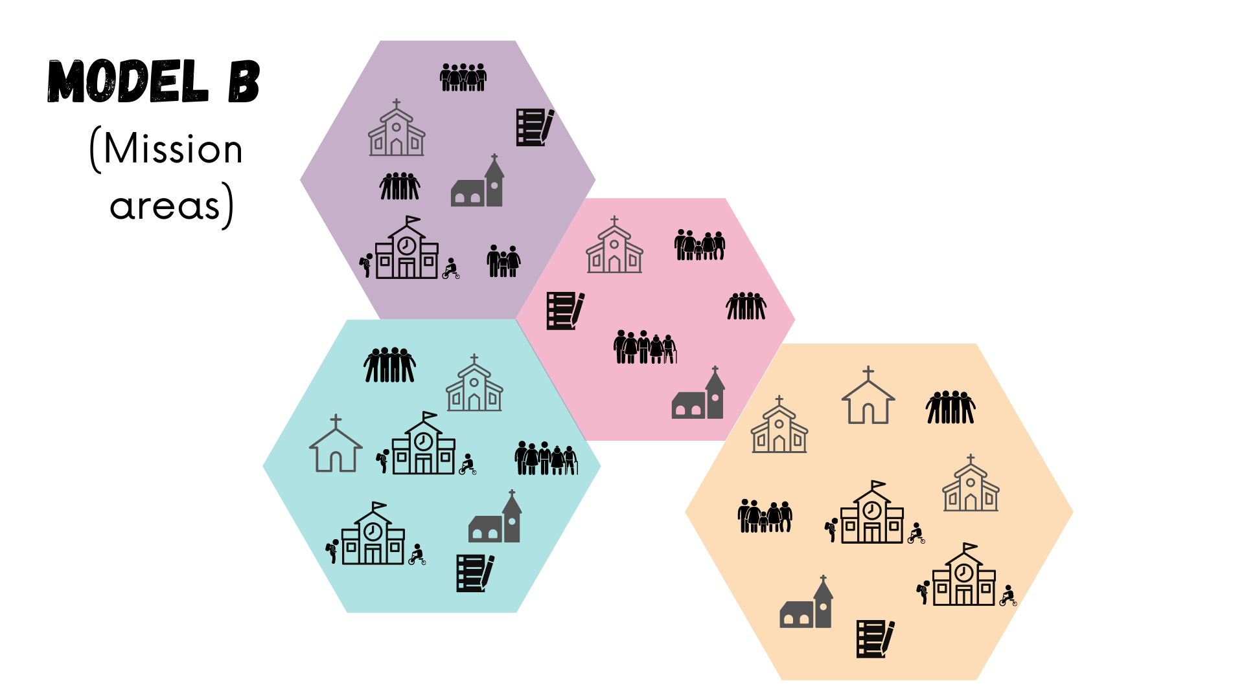
Model B

Slide 20
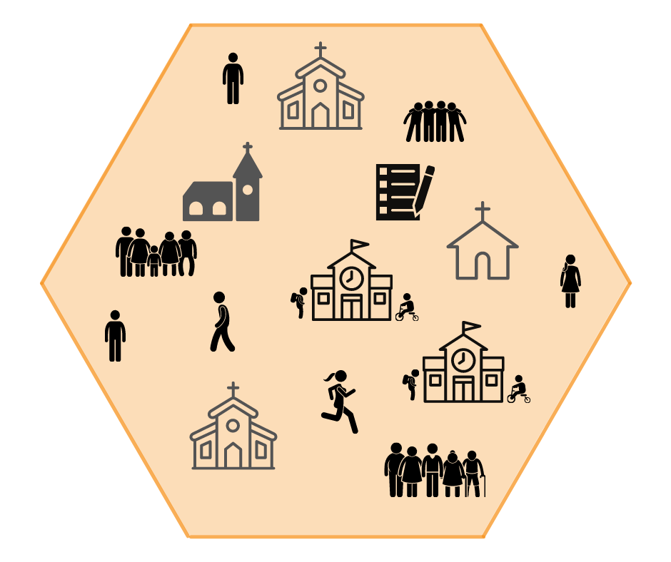
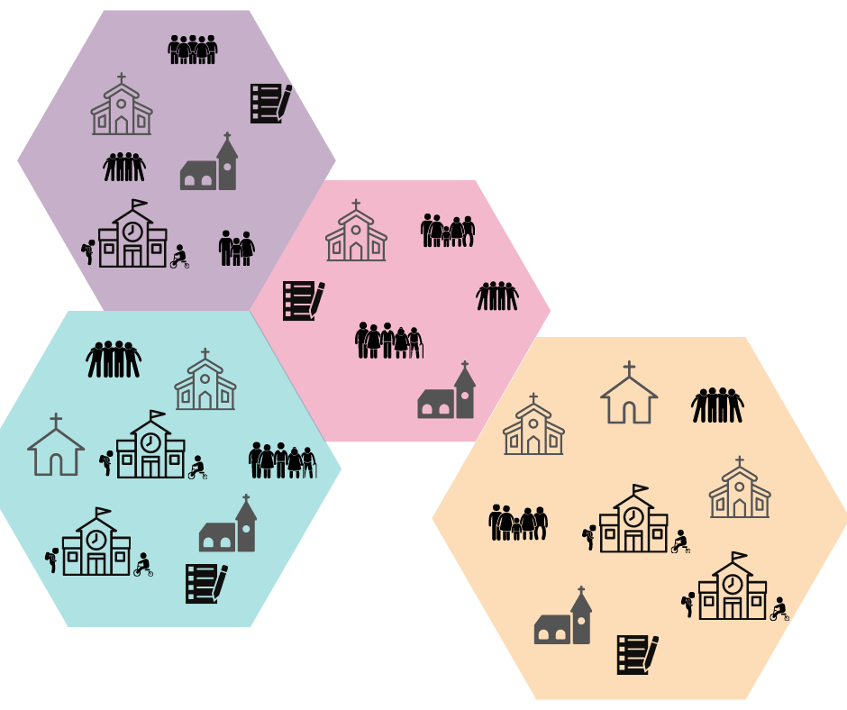
Model B
Examples:
A group of Parishes and Fresh Expressions of Church that serve a geographical area integrating Church, School & Households.
A geographical area could be a collection of school catchment areas.
A geographical area could be council boundaries.
A geographical area could be a large new build development.
A geographical area could be an existing deanery.
A geographical area could be accessibility of the local retail units (Where do you go to shop?)

Slide 21
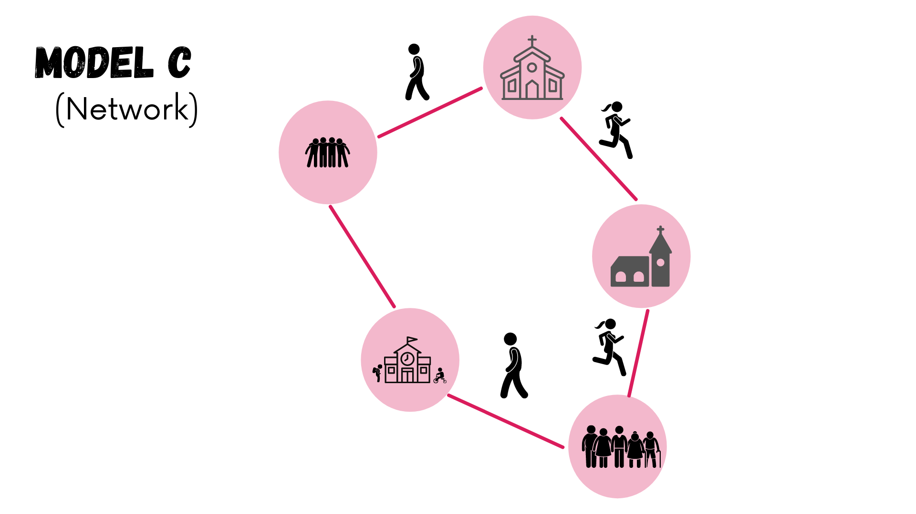
Model C

Slide 22
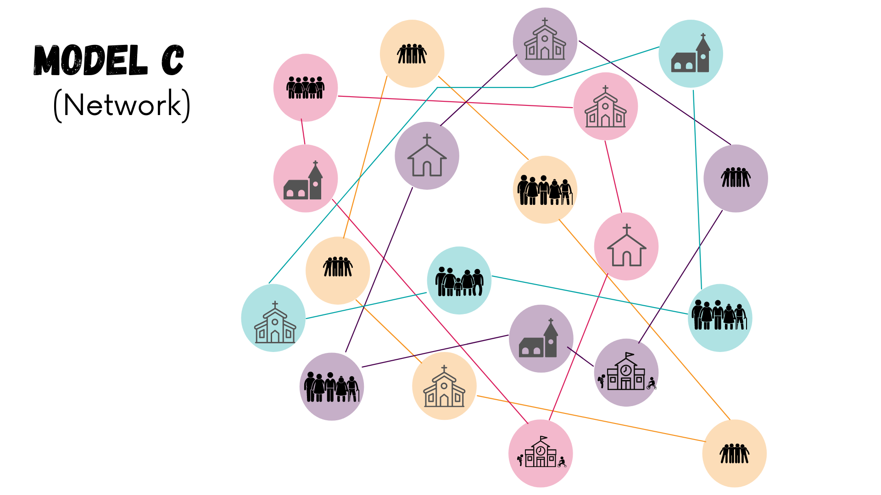
Model C

Slide 23
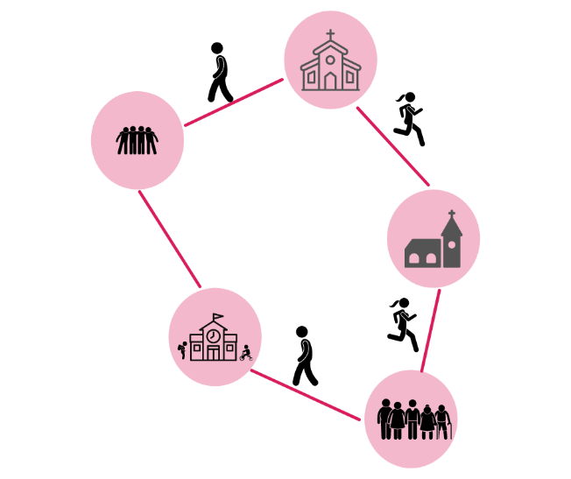
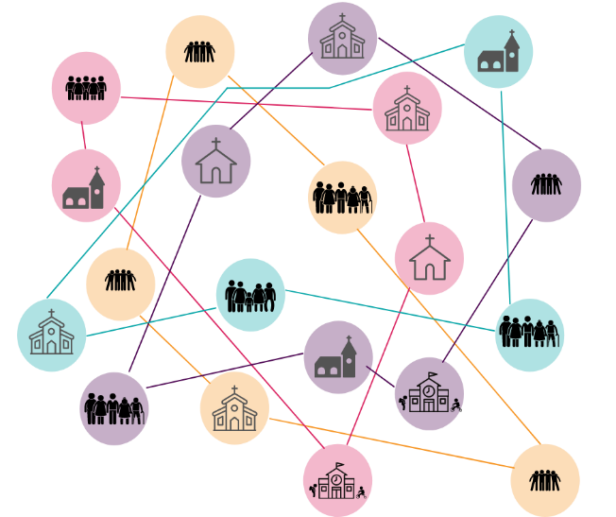
Model C
Examples:-
We are a network focussed upon …
Influencing and engaging with civic structures for missional purposes.
Practical action in response to a community need.
Creating new Christian communities, rooted in the Anglican tradition. (RC / FxC)
Being an incarnational presence at the heart of our community.
Sacramental mission.

Slide 24
Any questions of clarification on the models?

Slide 25
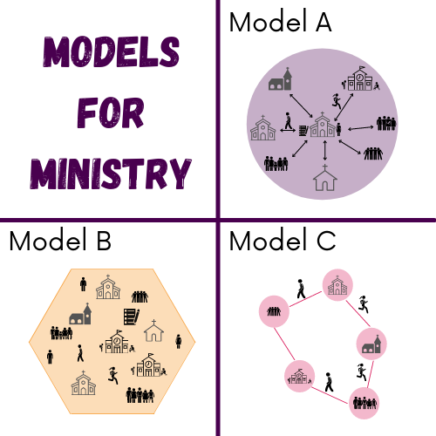
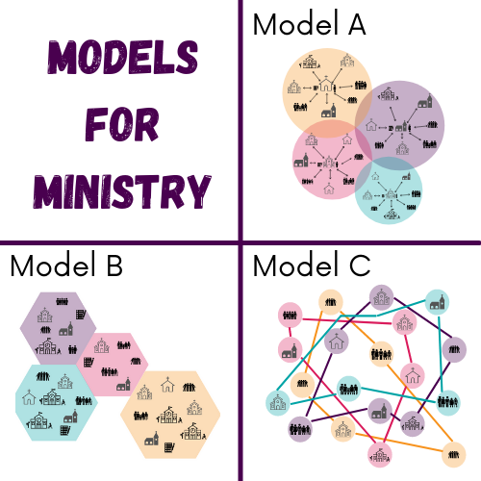
Intro to Feedback
Remembering that our current model of ministry is inadequate and unsustainable, and looking to the future, how well would this model, help us effectively live out the 3 key questions where we are?
0 1 2 3 4 5 6 7
I really can’t see it working I can see this working very well
As a church or fresh expression, what excites you about this model?
As a church or fresh expression, what concerns you about this model?
What would enable you to be more confident about this model?
Is there anything that would better help you understand this model?

Slide 26
Break

Slide 27
Conversation/Reflection/Feedback
Remembering that our current model of ministry is inadequate and unsustainable, and looking to the future, how well would this model, help us effectively live out the 3 key questions where we are?
0 1 2 3 4 5 6 7
I really can’t see it working I can see this working very well
As a church or fresh expression, what excites you about this model?
As a church or fresh expression, what concerns you about this model?
What would enable you to be more confident about this model?
Is there anything that would better help you understand this model?

Slide 28
Next steps

Slide 29
Closing Prayer
Invite each participant to hold in quiet prayer;
The discernment process
The conversation of the evening
To pray ‘Thy Kingdom come’

