Slide 1
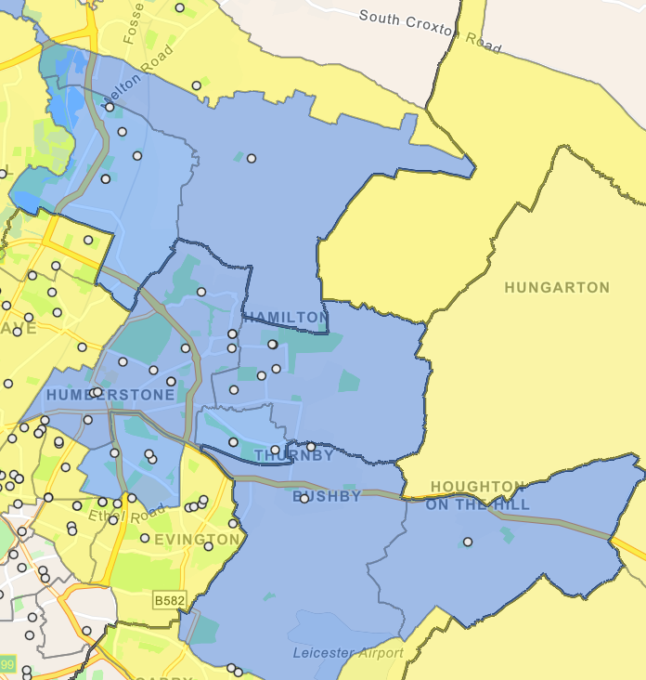
The Roundhill Academy
Bishop Ellis Catholic Primary School, Thurmaston
Eastfield Primary School
Church Hill Infant School
The Pochin School (Primary)
Hope Hamilton Church of England Primary School
Gateway Sixth Form College
Oakham House (College)
Falcons Primary School
Humberstone Infant Academy
Merrydale Infant School
Merrydale Junior School
St Barnabas Church of England Primary School
Al-Aqsa Schools Trust (Islam)
Rowlatts Mead Primary Academy
Rowlatts Hill Children’s Centre
All Schools
Kestrel Mead Primary School
Keyham Lodge School
Nether Hall School (Special School)
Orchard Mead Academy (Secondary)
Netherhall Sure Start Children’s Centre
Scraptoft Valley Primary School
St Josephs Catholic Academy (Primary)
Fernvale Primary School
Willowbrook Mead Primary School
Thurnby Mead Primary Academy
Houghton-On-The-Hill Church of England Primary School
Thurnby, St Luke’s Church of England Primary School

