Slide 1


AChurchNearYou.com
The official, free website platform for Church of England churches and benefices

Slide 2


Overview

Slide 3
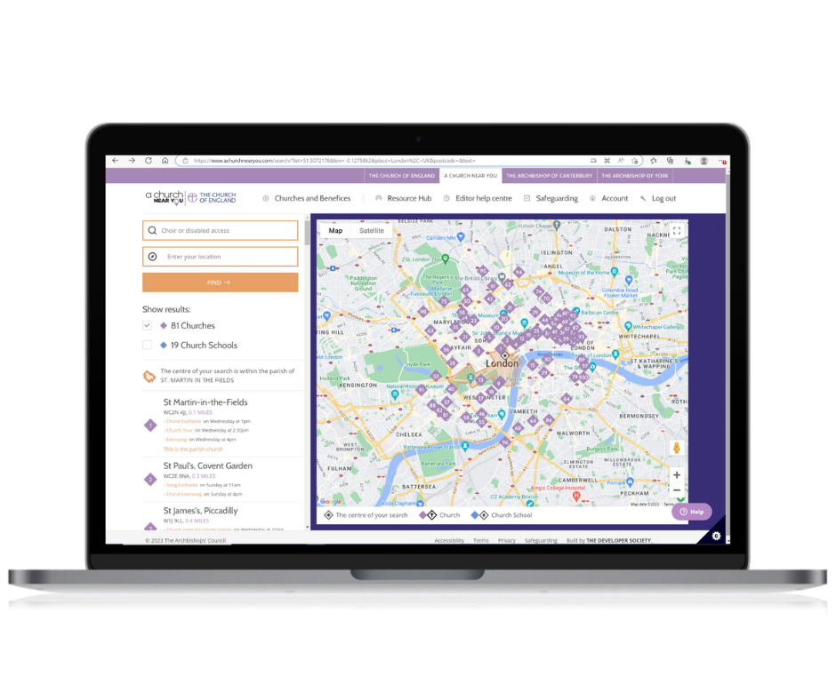
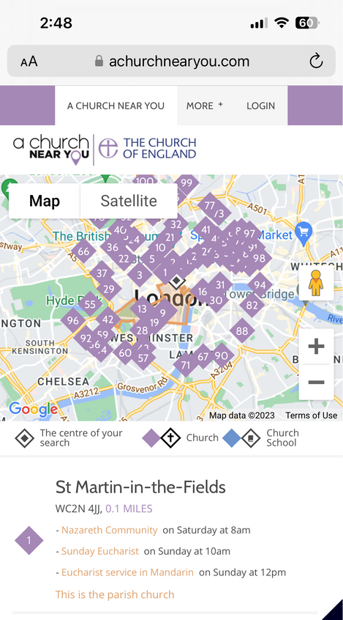
What is AChurchNearYou.com?
1. A church finder tool for the public:
AChurchNearYou.com allows anyone to find their nearest church, view information about that church community and get in touch.

Slide 4
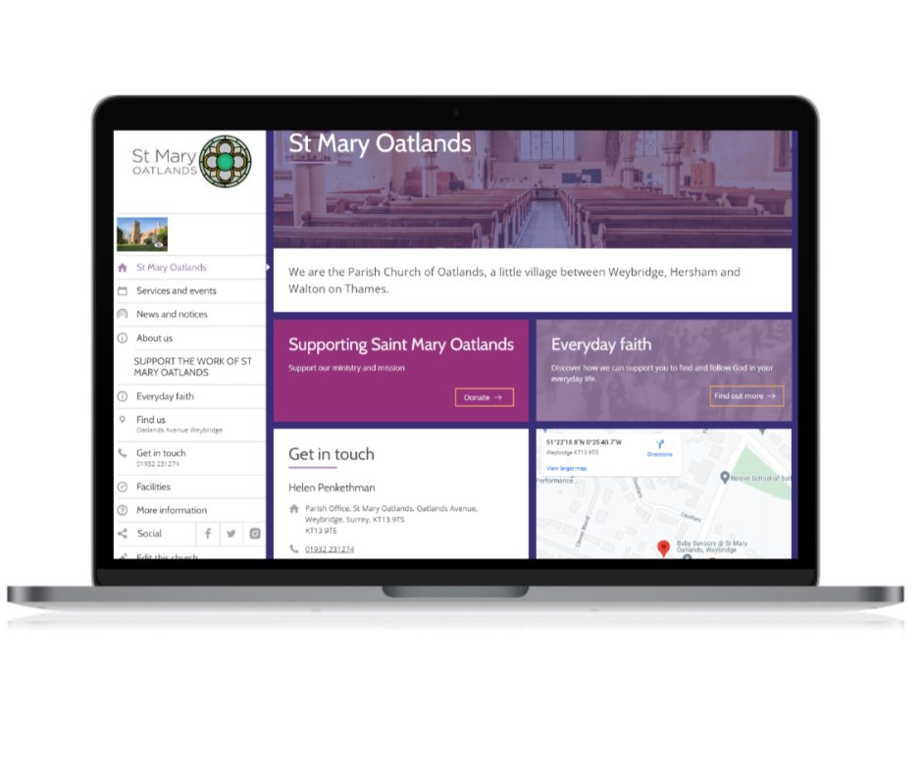
What is AChurchNearYou.com?
2. A free website platform for churches:
Every church or multi-church benefice can easily have their own free, easy to use website on AChurchNearYou.com.

Slide 5
How it works
Every Church of England church has a listing on AChurchNearYou.com, but it’s up to you how you use it.
You have two options:
  1. Keep your listing short and simple, with a button to take people to your separate church website
  2. Build out your listing into a full website, hosted within AChurchNearYou.com
If you want to, within AChurchNearYou.com you can also set up a website for your multi-church benefice, suitable if you are a Team Parish, Team Ministry or similar.
Notes:
try different background colour and also - a clear box
We need a mobile, and iPad views of the - Alessi to share screenshots
Benefice screenshots stop showing the old and only show the new features
slide 30: use Sketchy circle
Slide 35: the spacing on the bullet points is a little wierd

Slide 6
Why keep your listing up to date?
AChurchNearYou.com receives over 70 million page views per year. By keeping your church’s listing up to date, you can benefit from this traffic and help more people find your church.
  “This Sunday one of the Church Wardens came up to me after the service and said that she had had an email from AChurchNearYou.com from a lady asking where the service was in the benefice. She had replied immediately and the lady was in church with us!”
40% respondents to our last editor survey said they had had people come to their church as a result of their AChurchNearYou.com listing.​
Notes:
try different background colour and also - a clear box
We need a mobile, and iPad views of the - Alessi to share screenshots
Benefice screenshots stop showing the old and only show the new features
slide 30: use Sketchy circle
Slide 35: the spacing on the bullet points is a little wierd

Slide 7




In numbers
70 MILLION
Pages viewed annually by the public
Busiest day of the week on the site
SUNDAY
Editors have had visitors to their church who say they found the church on AChurchNearYou.com
Average number of pages viewed per session
4
40%
Sources: Page views from server logs, total from last 365 days prior to 14 Jun 2023, less 22% as we estimate these are editor page views. Pages per session, busiest day and first time visitors from Google Analytics, last 365 days prior to 14 Jun 2023. Editors reporting visitors to their church – Editor survey May 2021 w/ 300 participants.
Notes:
Sources:
Page views from server logs, last 365 days prior to 14 Jun 2023, minus 22% which are editor page views.
Pages per session, busiest day and first time visitors from Google Analytics, last 365 days prior to 14 Jun 2023.
Editors reporting visitors to their church – Editor survey May 2021 w/ 300 participants.
7

Slide 8
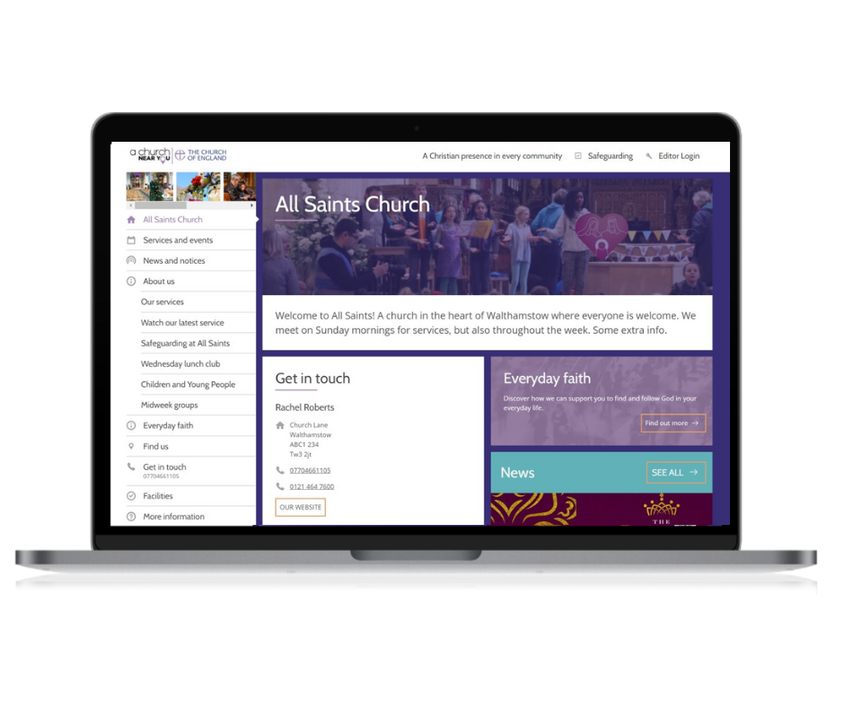
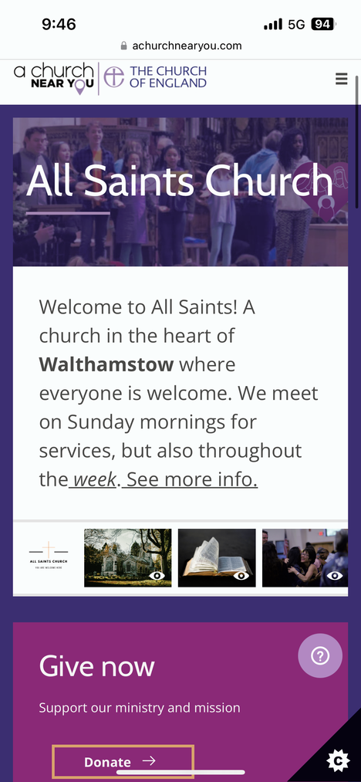
Church site example

Slide 9
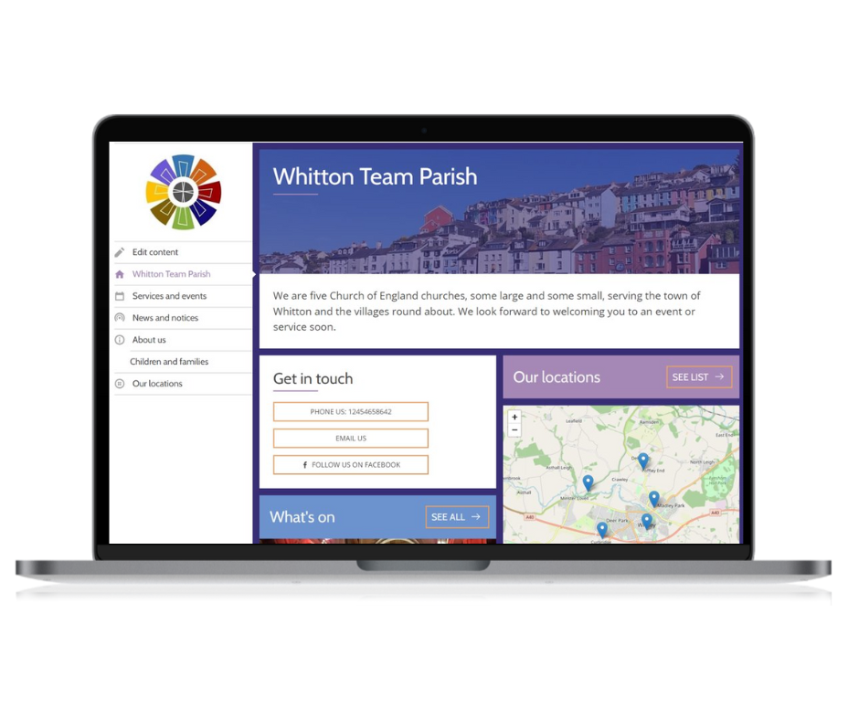
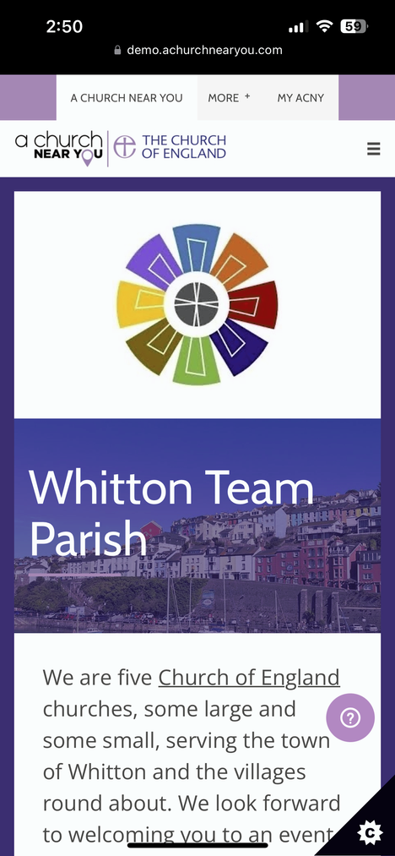
Benefice site example

Slide 10
Using AChurchNearYou.com as your main church or benefice website

Slide 11
“For a church with no one who understands the underlying technology it is a good idea, especially as mobile devices can be used to edit. Thank you very much for providing this service.”

Slide 12
Mobile friendly: Google prioritises mobile friendly sites, meaning your site will often appear on the first page of results
1
Completely free: no developer or admin fees
5
Simple to update: designed for people with no website experience
Reach new audiences: Drives the public to discover churches at key times of the year through several different digital platforms
2
BENEFITS
6
Training and support: help articles, how-to videos, regular training webinars, or contact us Mon - Fri
3
7
Continuous improvement: editor feedback shapes our development plans
4
Secure: we handle site security and access
Notes:
Completely free – no costs for hosting, setup or development.
Simple to update – designed for people with no prior website experience
Training and support - 'how to' guides and videos, regular daytime and evening webinars, and a support team to answer your questions.
Secure – Never lose access to your website again, even if volunteers leave.
Mobile friendly and visible on search – Google search prioritises web pages which are mobile friendly. Your AChurchNearYou.com site will often appear on the first page of search engine results for your church.
Reach new audiences – At key times of the year, such as Lent and Easter and Advent and Christmas, the Church of England drives the public to discover churches on AChurchNearYou.com through adverts, social media posts and printed resources.
Continuous improvement – Always responding to editor feedback. We are continuously developing the site features and design in response to editor feedback - see what's coming soon.
9

Slide 13
Key features
Contact form
Add your own pages
Customisable homepage
Multi-church benefices
Embed video
Easily receive and respond to messages from the public by forwarding them to an email address of your choice
Easily display your latest recording if you film your services
Add your own pages to highlight aspects of church life
Highlight upcoming events and key news, add online donation button
List your content at benefice level and have it display on all your church sites as well as the benefice site

Slide 14
Optional extras
Church Development Tool
Life Events Diary
Online giving
Room booking page
Online Services Register
Simple tool to survey your congregation
A quick and easy way to collect all the details from visitors enquiring about weddings, christenings & funerals
Add an online giving button to your homepage
Add a Room Booking page to ease bookings admin
List your service attendance online, making it quicker to complete your Statistics for Mission form at the end of the year

Slide 15
Is AChurchNearYou.com right for me?
For many churches, AChurchNearYou.com offers everything they need, with zero cost,making it the best choice of website for them.
  Some churches with staff and a budget to run a separate website prefer to do so with other website providers, rather than using AChurchNearYou.com as their main website.
  These churches can add just their basic information on AChurchNearYou.com, including providing a contact email address and a link to their main website.​
  We recommend logging in twice a year to list your Easter and Christmas events, to make sure you don't miss out on getting noticed by the boosted visit﻿or numbers that come to find a church on AChurchNearYou.com at these times of year.

Slide 16
What will my website address (or URL) be?
The default URL will be something like achurchnearyou.com/church/12345.
To customise the address, you can:
  Contact us and ask for an alternative URL with your church name in it, this will be in the format achurchnearyou.com/all-saints-millington.
  Purchase a new custom URL, for example, ‘allsaintschurchmillington.org’ from any domain name provider, and set it to forward to your AChurchNearYou.com URL.
  If you already have custom URL for a separate website, but want to move to AChurchNearYou.com, you can redirect it to your AChurchNearYou.com URL.

Slide 17
Getting started

Slide 18
“This Sunday one of the Church Wardens came up to me after the service and said that she had had an email from ACNY from a lady asking where the service was in the benefice. She had replied immediately and lo! the lady was in Church with us!”

Slide 19








Become an editor
1 - Register
2 - Request access
3 - Approval
4 - Learn
Register at achurchnearyou.com/accounts/signup/
and login
Request access to your church(es):
  Look up your church on AChurchNearYou.com
  Choose 'Edit this church' from the church's menu
  Fill out the form
Approval of your request by an existing editor of that church. In case of any problems or delay, contact us for approval at cofe.io/SupportACNY
Book onto a short training webinar at cofe.io/WebinarsACNY. Or, watch videos and read help articles when it suits you, at cofe.io/EditorHelpACNY

Slide 20
AChurchNearYou.com as your main website
  Use the URL (web address) that we give you or redirect your existing domain name to your AChurchNearYou.com site.
  Add your contact details and your regular services, then make use of the options to add custom pages, and news listings to fill out a full site.
  Explore our benefice functionality to save you time if you need to list the same events and information on multiple churches.
  Visit the Marketplace on the editor menu for more free options, including adding a 'donate' button to your homepage.

Slide 21
What could my church site look like?

Slide 22
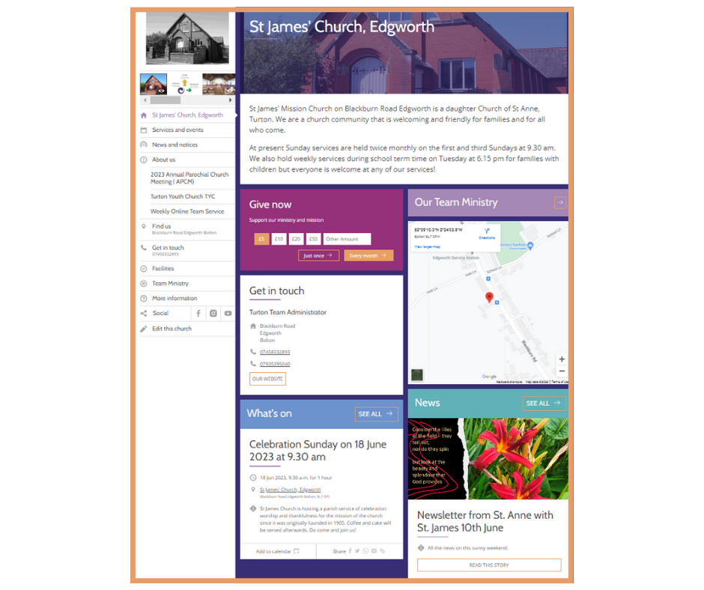
  Homepage
  Services and events
  News and notices
  About us
  Custom pages
  Find us
  Get in touch
  Facilities

Slide 23
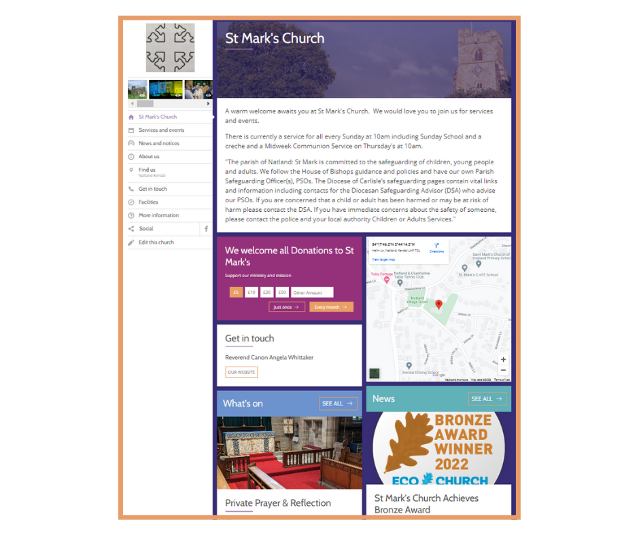

Find it n the Marketplace
Homepage
Your church’s homepage is the first page visitors will see when they arrive on your site.
You can edit the church’s homepage to include useful information for the church community and new visitors.
Other customisable features include highlighting upcoming events and key news, and adding an online donation button.
Editor Help Centre Article

Slide 24
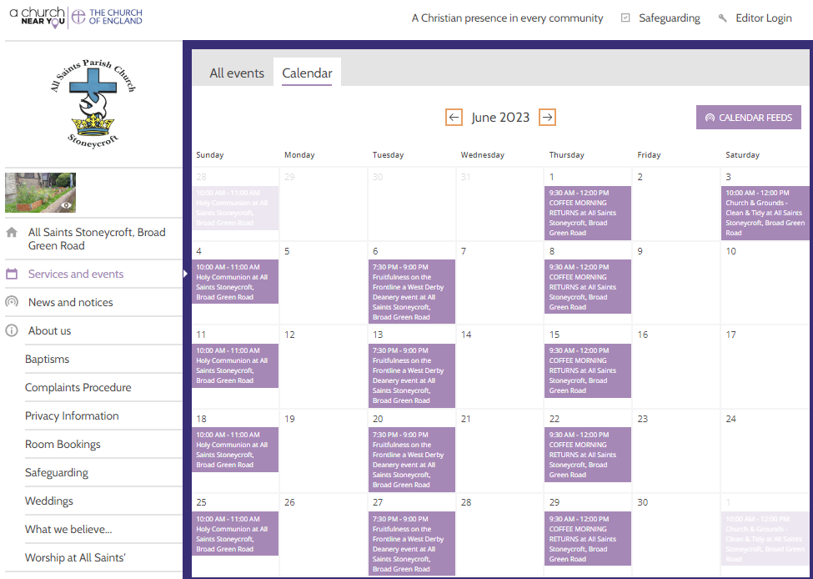
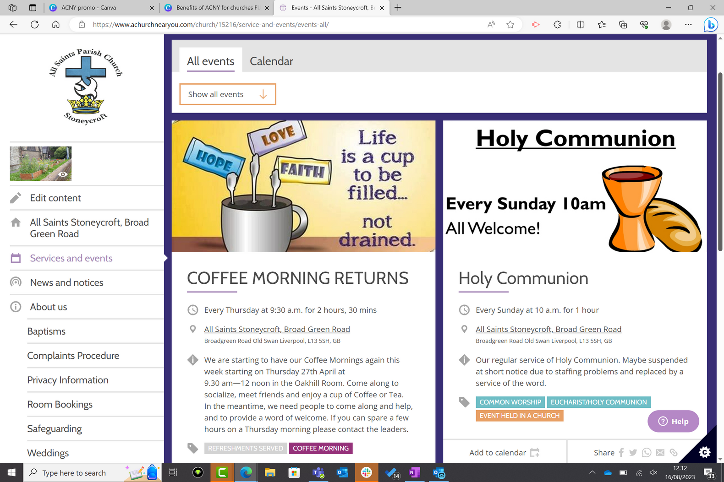

Services and events
Editor Help Centre Article

Slide 25
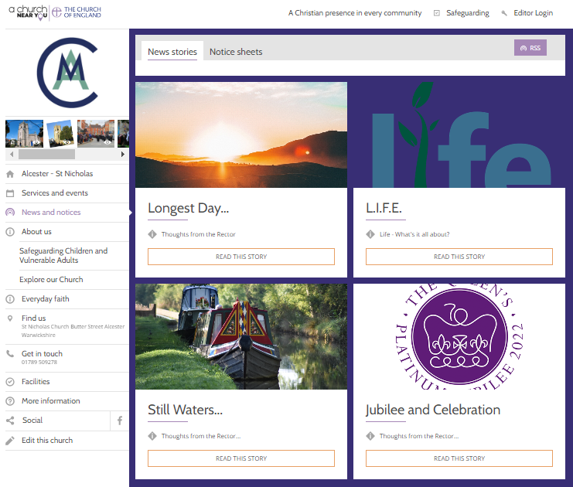
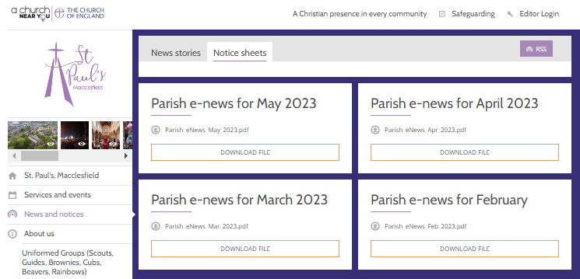
Find it n the Marketplace
News and notices
Editor Help Centre Article

Slide 26
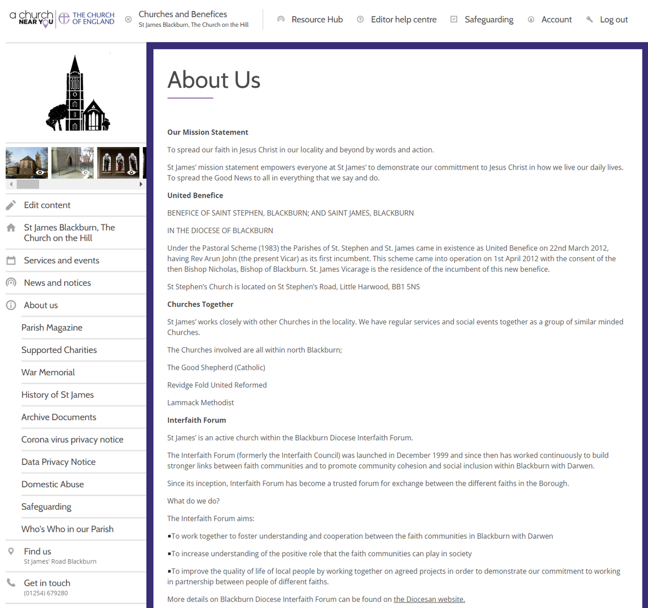
Find it n the Marketplace
About us
The about us page on your site provides a space to tell visitors more about the life and community at your church or within your benefice.
Editor Help Centre Article

Slide 27
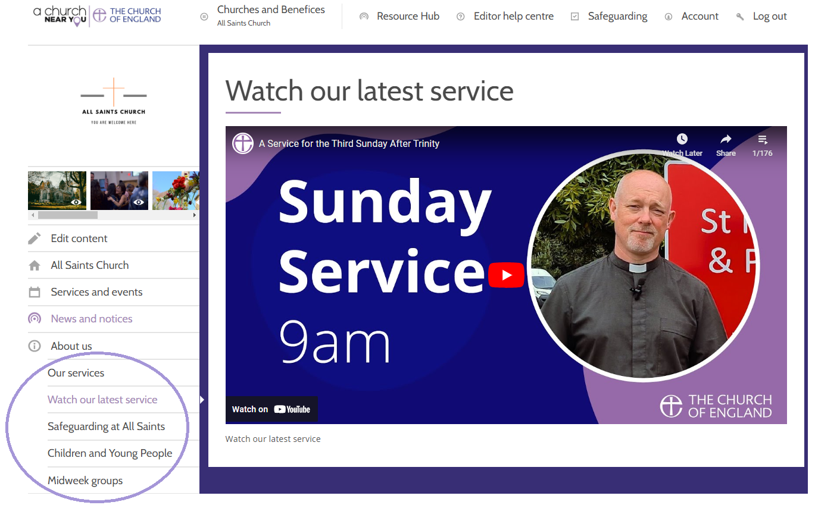
Find it n the Marketplace
Custom pages
Add your own pages to highlight aspects of church life.
Churches often create custom pages for weddings and funerals, safeguarding, or social action projects as examples.
Editor Help Centre Article

Slide 28
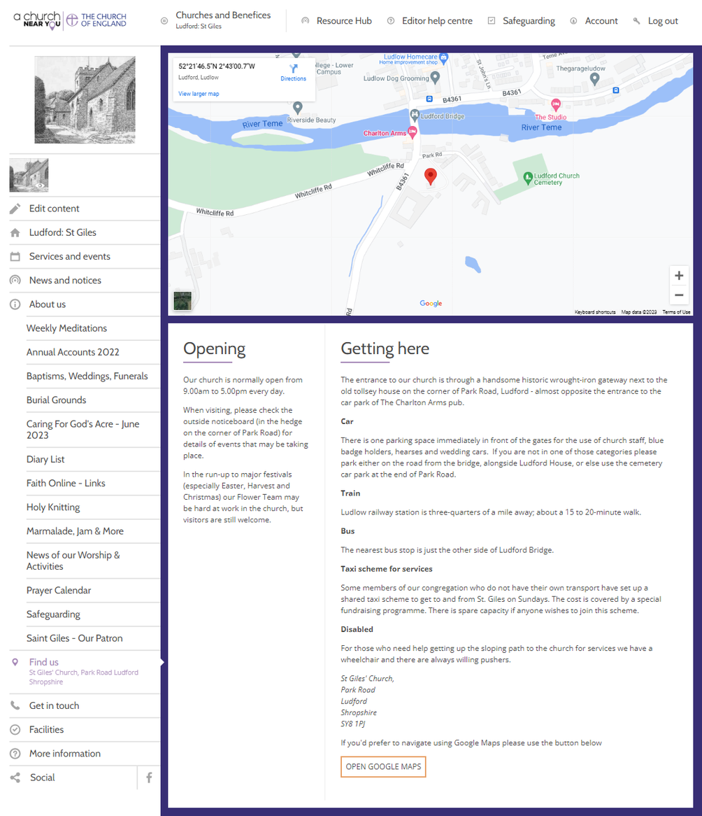
Find it n the Marketplace
Find us
Tell people how to find you on the Find us page.
Bus routes, parking information and the numbers for local taxi firms will help new visitors feel welcome.
Editor Help Centre Article

Slide 29
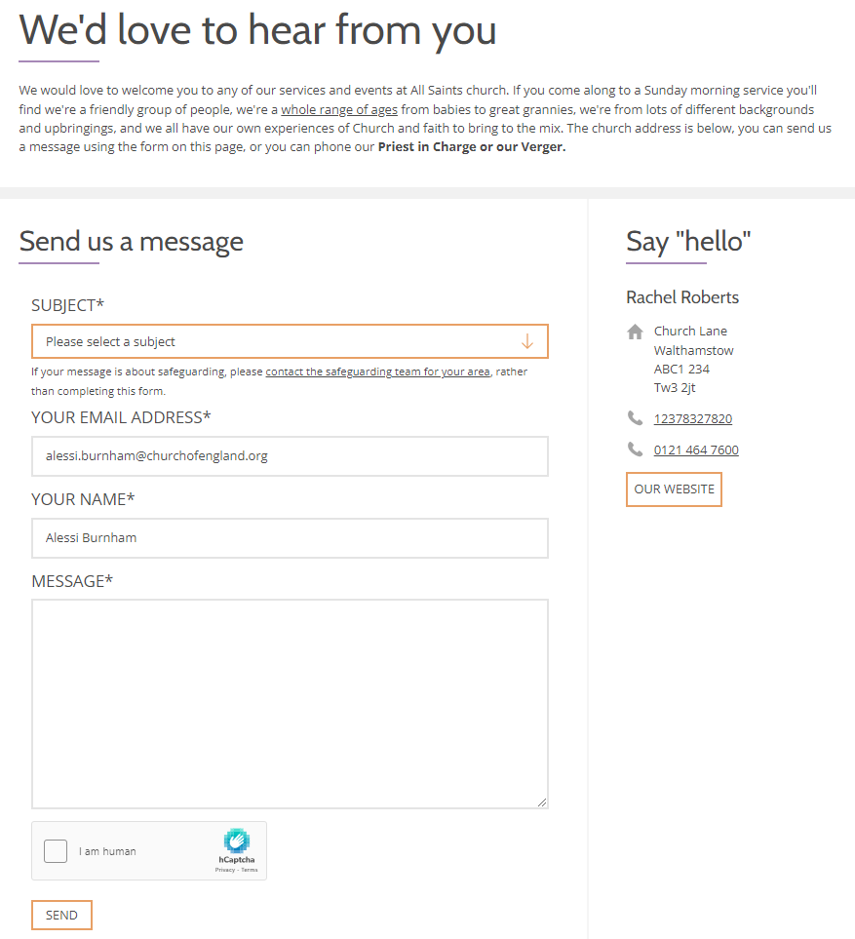
Find it n the Marketplace
Get in touch
Visitors can use the get in touch page to contact the church through the inbox and to find the contact number and web address.
All messages you receive via the site are sent direct to an email address of your choice for you to reply from.
Editor Help Centre Article

Slide 30
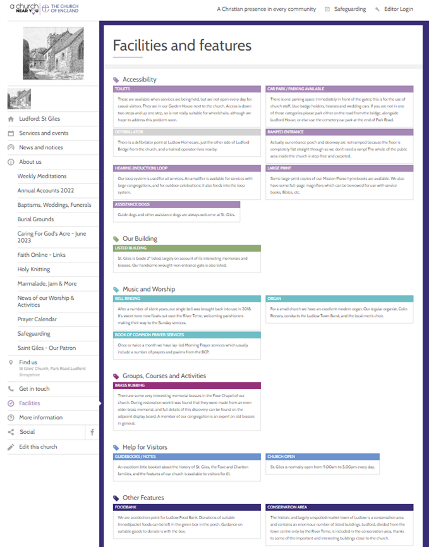
Find it n the Marketplace
Features and facilities
Facilities tags highlight the features and facilities of your church building or community.
Visitors to the site can search for a church which has a specific feature; for example, a ramped entrance or accessible toilet.
Adding tags to your site, such as these, will help them to feel more confident, knowing what to expect, when visiting for the first time.
Editor Help Centre Article

Slide 31
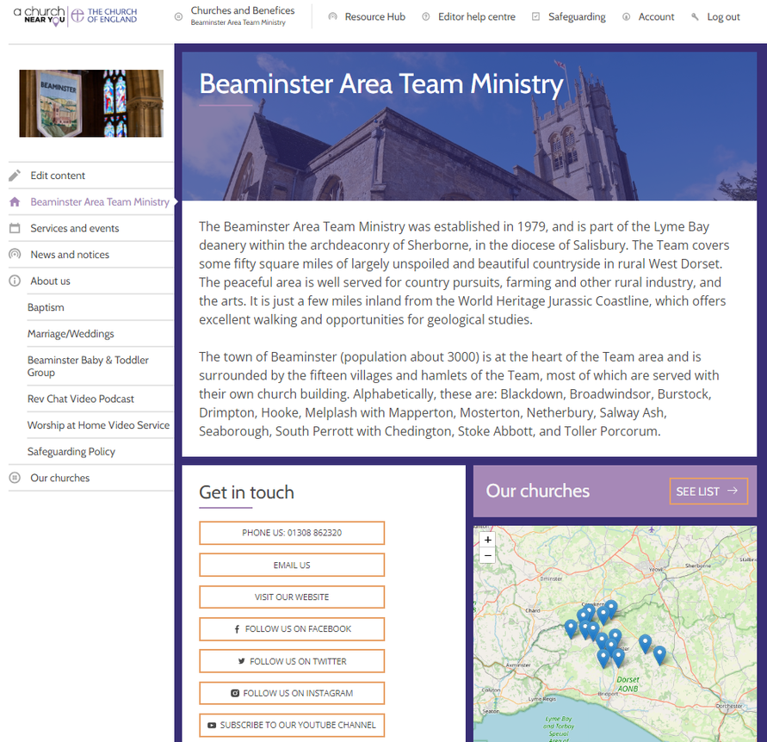
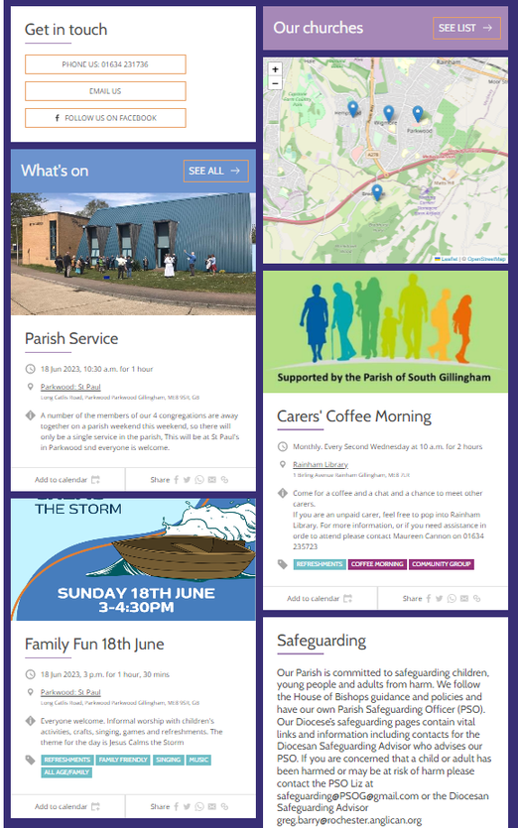
What could my Benefice site look like?
What could my Benefice site look like?
  Homepage
  Services and events
  News and notices
  About us
  Custom pages
  Church locations

Slide 32
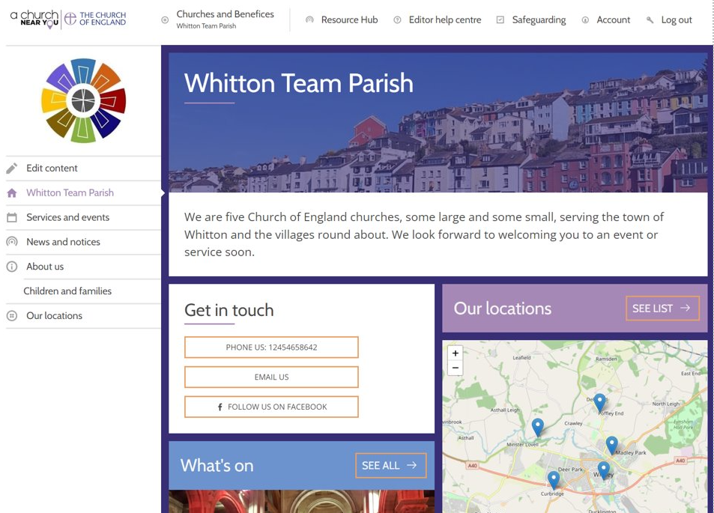
Benefice features
Find it n the Marketplace
Benefice sites with homepage, services and events page and more
Editor Help Centre Article

Slide 33
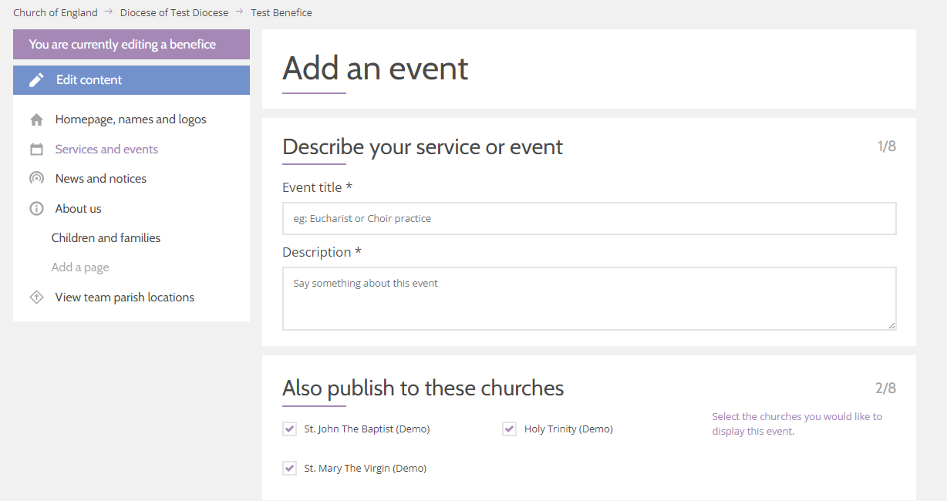
Benefice features
Find it n the Marketplace
Create and manage events and news and custom pages at benefice level and choose which churches should display them
Editor Help Centre Article

Slide 34
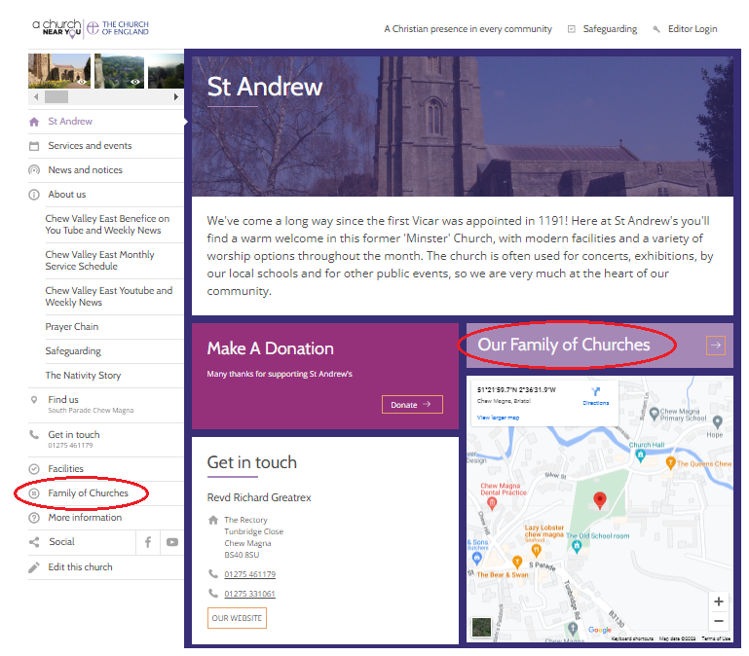
Benefice features
Find it n the Marketplace
  Option to swap out 'benefice' language, to suit what you use locally
  Flexible options for linking to benefice sites from church sites
Editor Help Centre Article

Slide 35
Extra features

Slide 36
“We love the new benefice feature and works really well for our two locations in the same parish.”

Slide 37
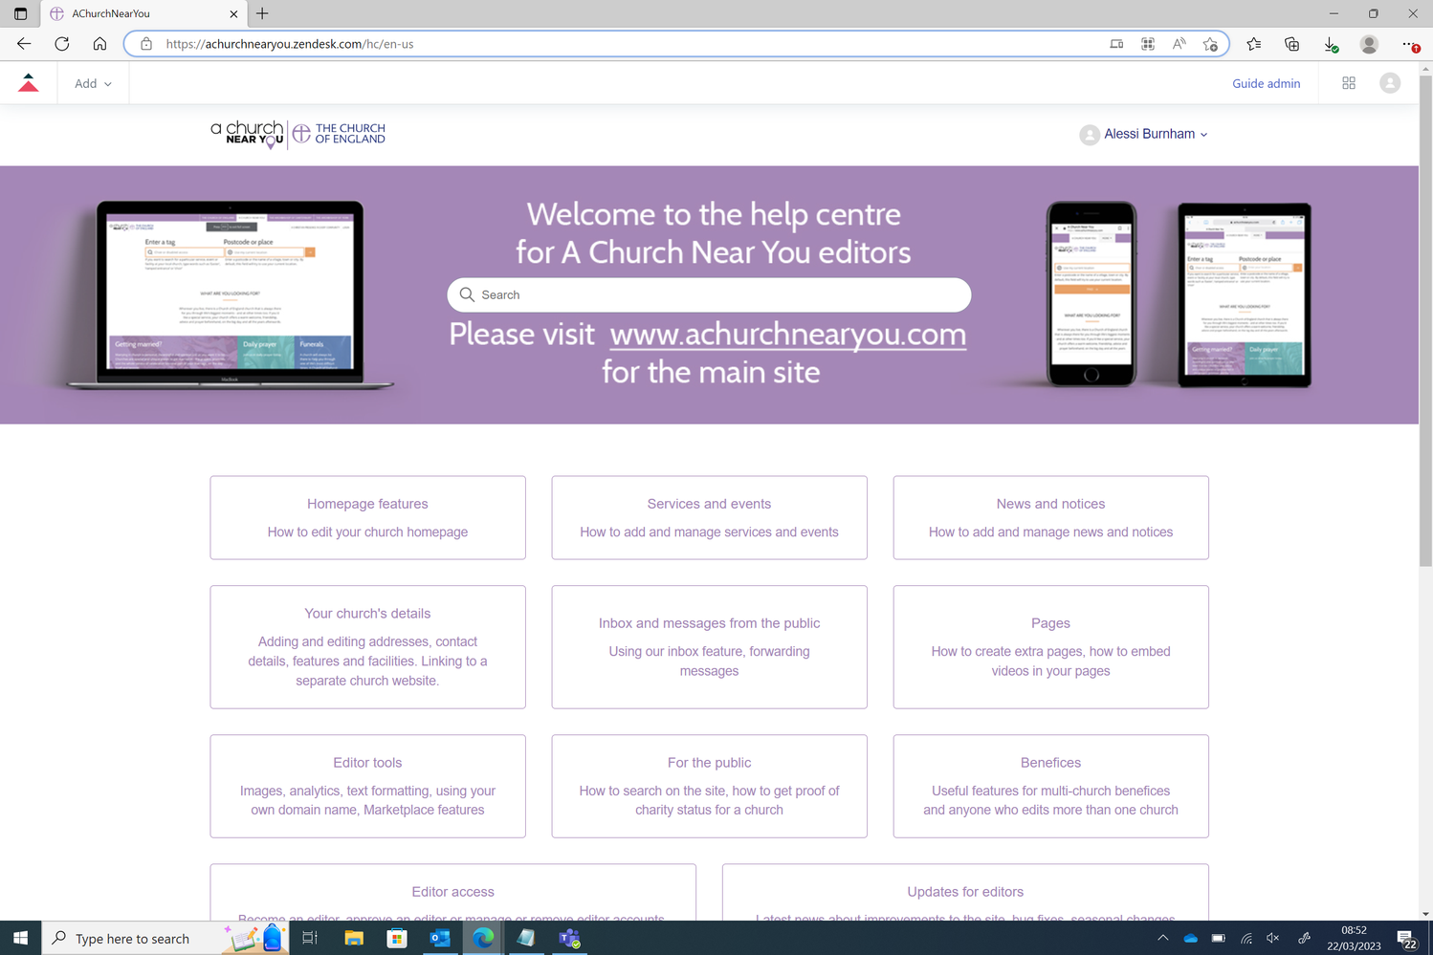
Editor Help Centre
The articles in the editor help centre provide answers to common queries,
'how to' guides and videos.

Slide 38
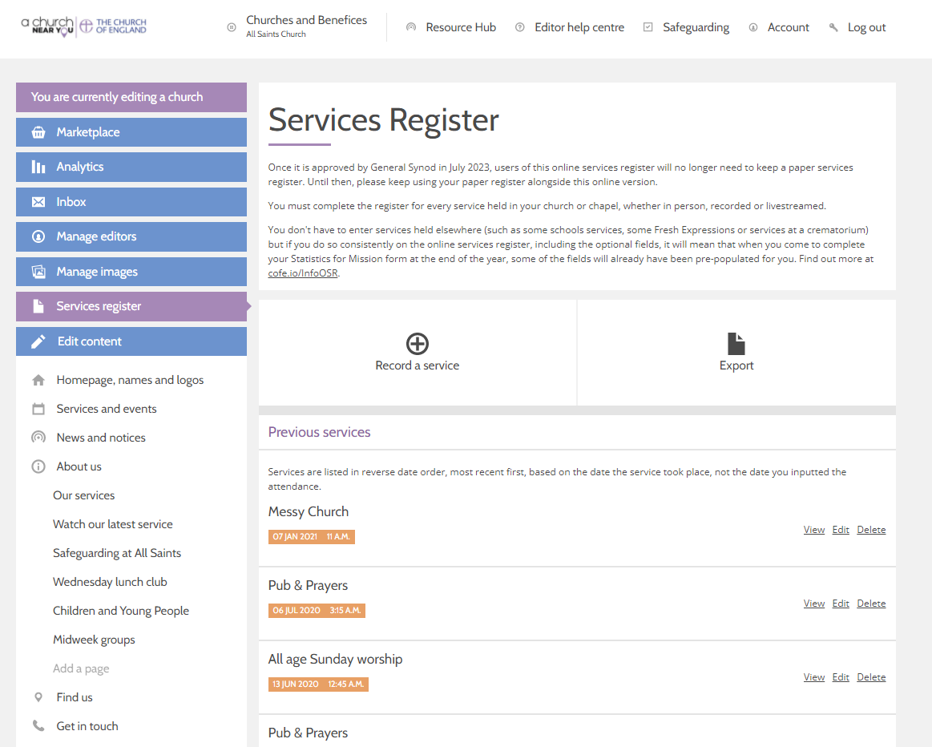
Online Services Register
  Option to switch from a paper Services Register to the online Services Register.
  Pre-populates attendance figures in your Statistics for Mission form, meaning less admin at the end of the year.
  Add entries while offline and they will be synced when you are online again.

Slide 39
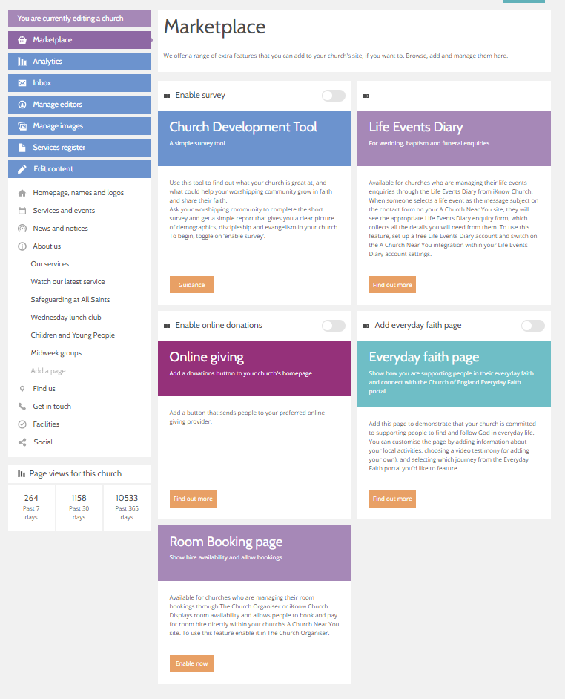
Get more in the Marketplace
We offer a range of extra free features – it's completely optional and up to you whether you use these.
  Church Development Tool
  Life Events Diary
  Online giving button
  Everyday Faith page
  Room Booking page

Slide 40
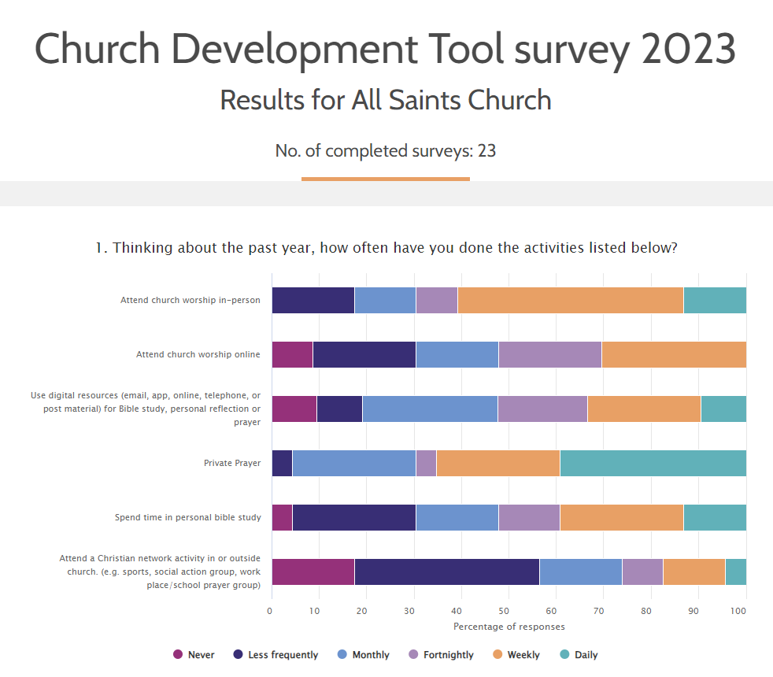
Church Development Tool
Use this simple survey tool to find out what your church is great at, and what could help your worshipping community grow in faith and share their faith.
Get a simple report that gives you a clear picture of faith, discipleship and demographics in your church.
The demographics results for your congregation are shown in comparison to census data for the whole community in your parish.

Slide 41
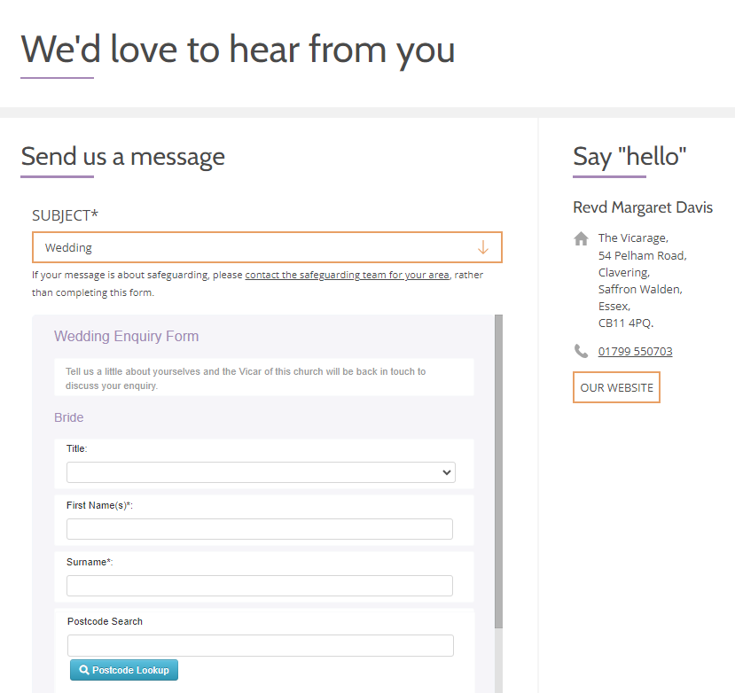
Life Events Diary
Do you use the Life Events Diary? Save time by connecting AChurchNearYou.com to your Life Events Diary account.
Then, when someone uses your AChurchNearYou.com contact form to enquire about a Wedding, Baptism or Funeral, they will be shown your Life Events Diary enquiry form and the information they provide will appear in your Life Events Diary account.

Slide 42
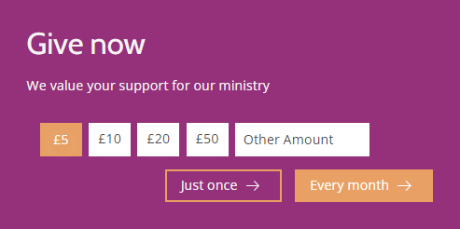
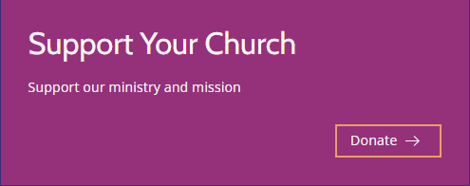
Online giving
Add a panel to your homepage, that sends people to your preferred online giving provider.
You can change the words displayed on the panel and the button.
If your provider is Give A Little, the panel can have multiple buttons for people to give different amounts.

Slide 43
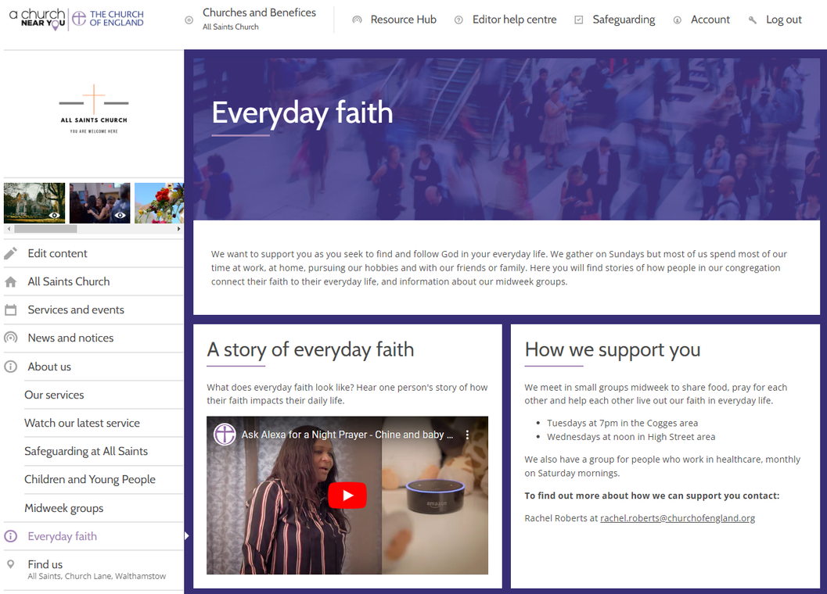
Everyday Faith page
Show how you are supporting people in their faith Monday to Saturday by adding an 'everyday faith' page, fully populated and ready to use as is or to customise with your own content.
The page links people to the Church of England's Everyday Faith portal which is full of resources to help people grow in faith and discipleship. If you want, your everyday faith page can direct people to your selected Everyday Faith portal journey.

Slide 44
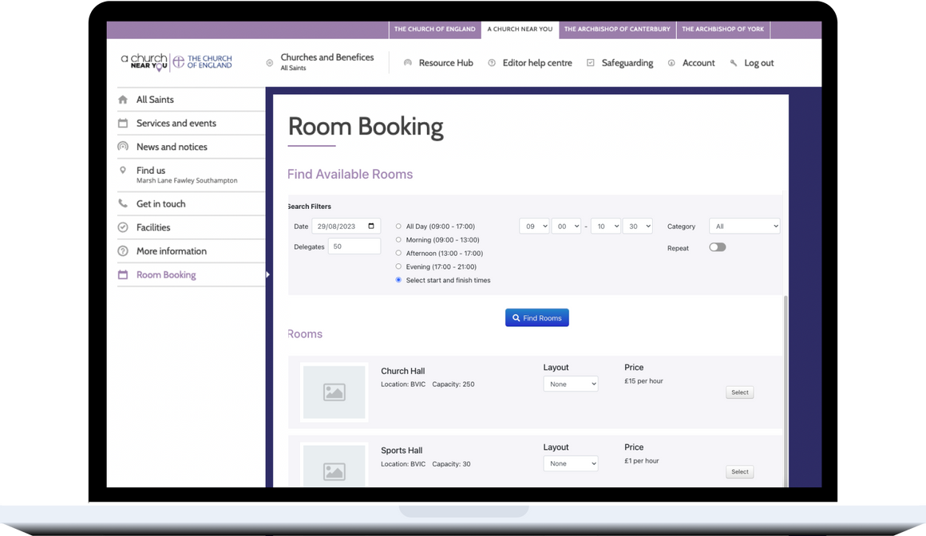
Room booking page
Do you have a room in your church building which you hire out to the community?
Connect your room bookings to your A Church Near You site to collect booking enquiries wherever you are, at any time of day.
This allows people to view, book and pay for rooms directly on A Church Near You. Within The Church Organiser you will then be able to approve or decline bookings.

Slide 45
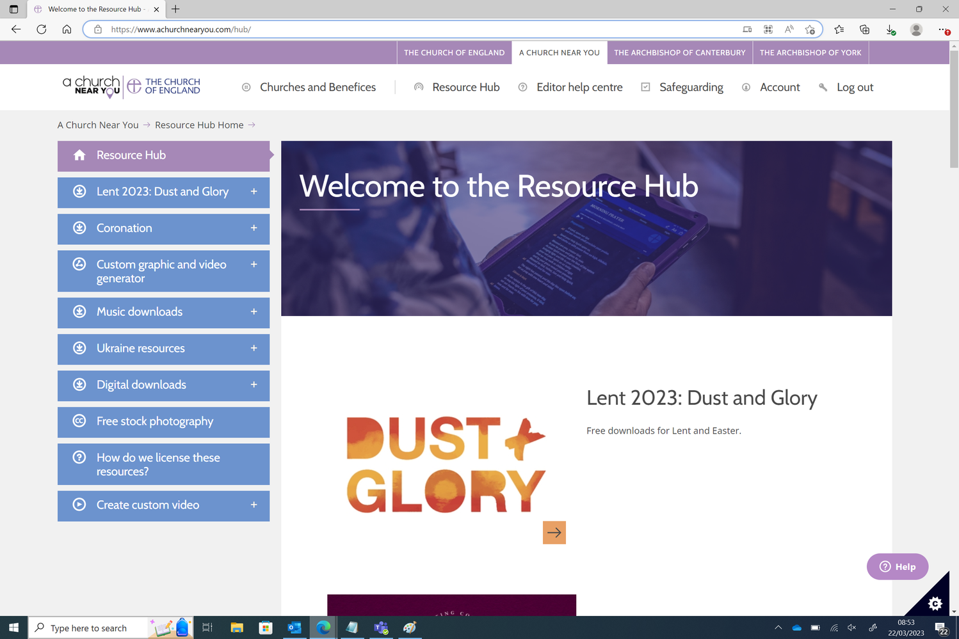
Resource Hub
The Resource Hub gives churches access to a wide range of free materials to use across their websites, social media, print and services.
It is regularly updated with new content, including social media templates, stock photography, music tracks, customisable videos and campaign branding.

Slide 46
Useful links
  Editor help centre: cofe.io/EditorHelpACNY
  Attend a webinar: cofe.io/WebinarACNY
  Get support: cofe.io/SupportACNY
  Submit your suggestions: cofe.io/SuggestionsACNY
  Future roadmap: cofe.io/RoadmapACNY

Slide 47

Blogs Webinars Newsletter Video training on-demand
Discover the free resources for churches
churchofengland.org/DigitalLabs

