Slide 1
Christmas Fundraising
Generous Giving Team
November 2020

Slide 2
Aim of meeting
To inspire you to try something new or deliver something virtually!
To provide some Christmas Fundraising Ideas
3. To give details of money collection methods
4. To provide promotional ideas

Slide 3
The three keys to fundraising success!
1st - Choose a simple fundraising idea that suits your community
2nd – Set up an online giving page
3rd - Promote your event and your online giving page!

Slide 4
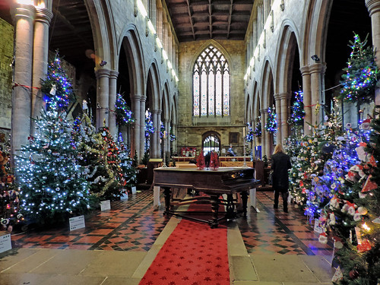
Christmas Fundraising Ideas
History – what has been successful previously?
Could it be done again virtually?

Slide 5
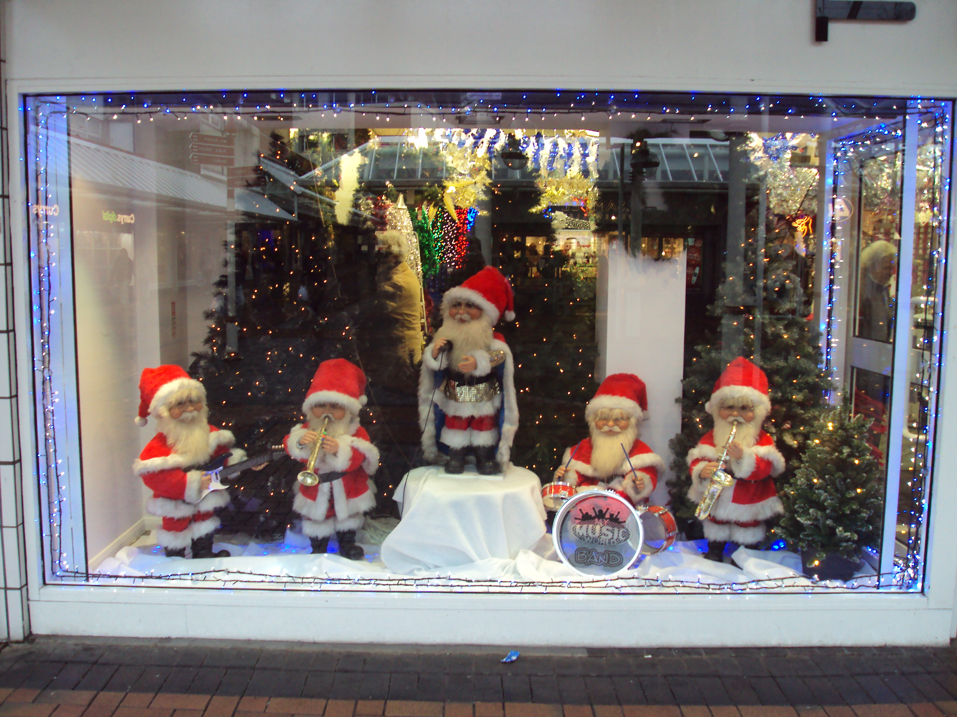
Christmas Fundraising – Advent
Christmas Fair
Christmas Tree Festival Trail
Christmas windows – perhaps showing Advent scenes

Slide 6
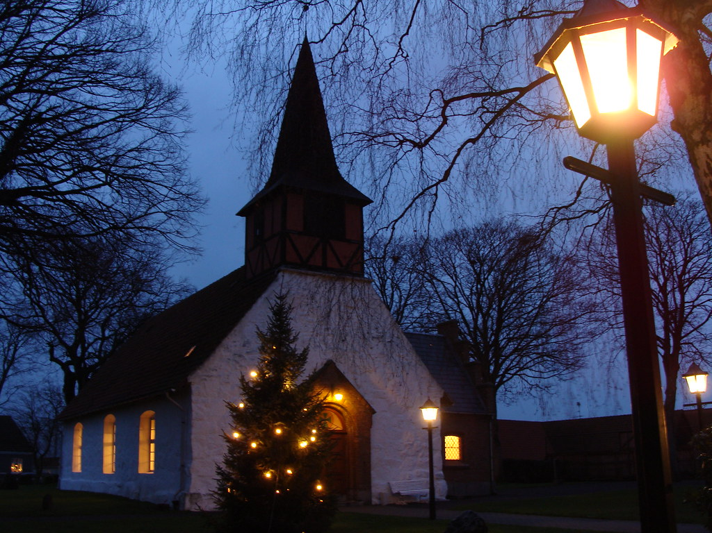
Christmas Fundraising – Advent
Christmas raffle
Light the church at Christmas (in memory)
Christmas cards

Slide 7
Christmas Fundraising - Events
Christmas movie nights – could it a Church Family activity
shared with the youth group?
Virtual challenges – challenge one person or a group to undertake a Christmas related challenge – Mary and Joseph walked 80 miles (took 4 days) to get to Bethlehem – could a group take on the challenge of walking 80 miles in 4 days?
Host a Christmas Quiz

Slide 8
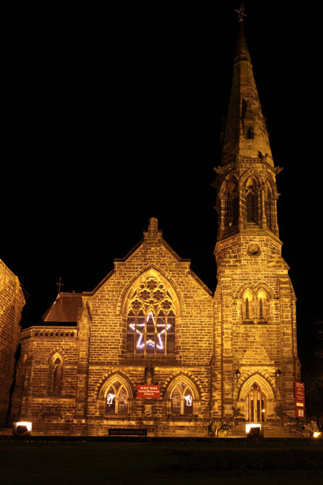
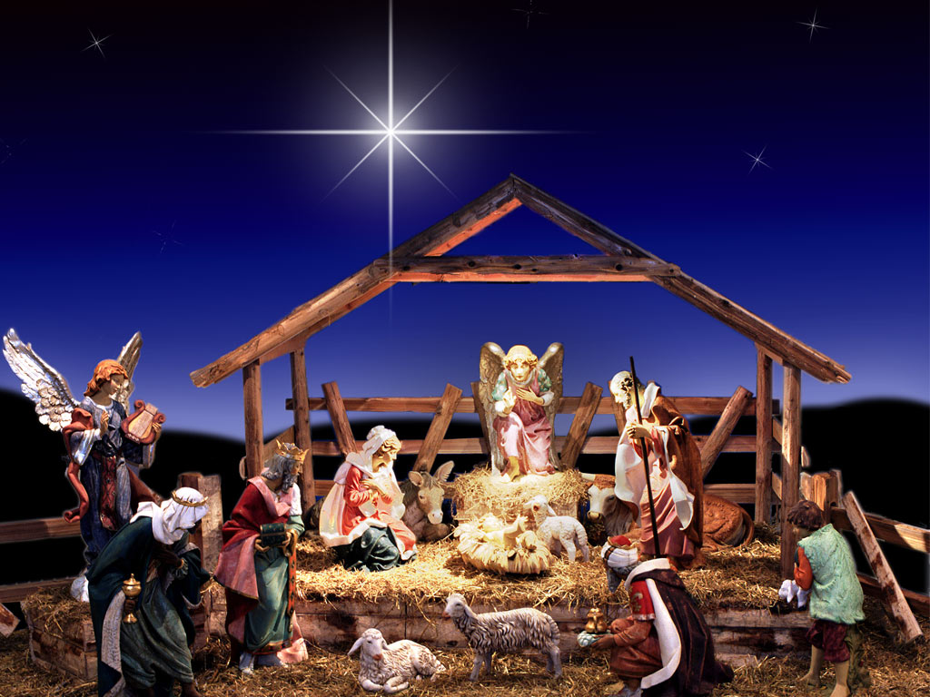
Discussion
What could be possible in your context?
Who would you need to help organise the event or challenge?

Slide 9
Promotional ideas
Use the main ways you communicate with your Parish community
Church services notices
Social media – is there a local facebook group for example?
Church website and other websites (Business might be persuaded to write We’re supporting the xxx on their website)
Local newsletters and magazines
Flyers through doors and in windows

Slide 10
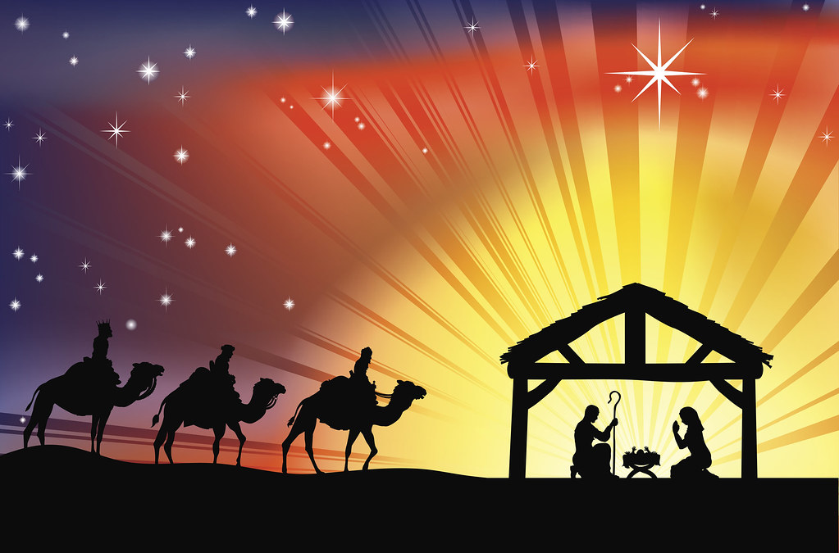
Promotional ideas
Emails
Local media
Don’t forget word of mouth! You can still use the telephone
Promote before the event, during the event and afterwards!
Other ideas?

Slide 11
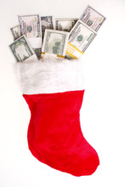
Collecting the money!
Don’t forget to ask people to donate!
Give them the details of how to do so!
Notes:
We may not realise that any barriers are there when it comes to giving.
By information I mean both information about the current financial situation and also information about how to give. This feels harder in times when we’re not using the building, and it means we have to do things a little differently.
Helping people to give in a way that works for them, whilst also thinking about what technical tools and solutions we need for a time like this, and to prepare us for the cashless future that I’ve talked about.

Slide 12
Tools for money collection
Contactless devices (could be used for raffles and set at a particular amount)
Online giving
Notes:
Contactless: will deal with quickly as this is less relevant for this time when churches are closed, but may be more relevant as they open, and for Christmas services if they are able to be held. Is good preparation for the future.

Slide 13
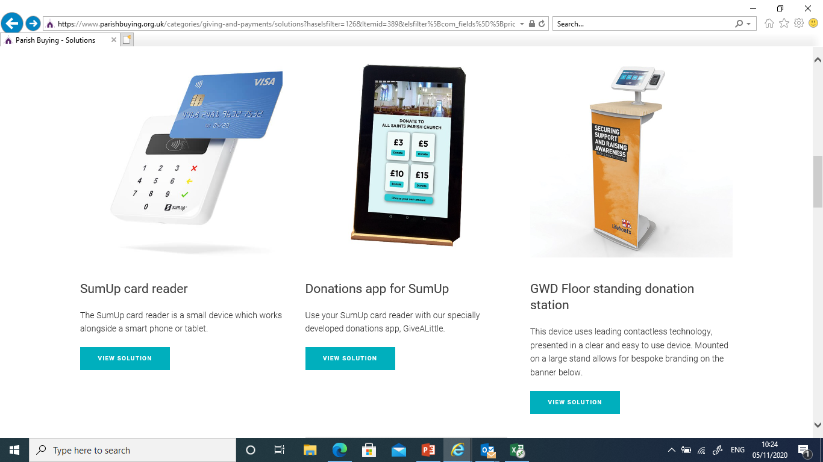
Contactless devices
Notes:
There are now a whole range of devices that you can use from ……….. SumUp preferred provider
Can be used for:
Collecting fees for occasional offices, and donations at weddings and funerals.
Retiring collections at services.
Fundraising events
Church stalls / bookshops and cafes
Enables everyone to give, even if they’ve come without cash – which a lot of people do.
All you need to do it go to parish buying (go to page!) and show.

Slide 14
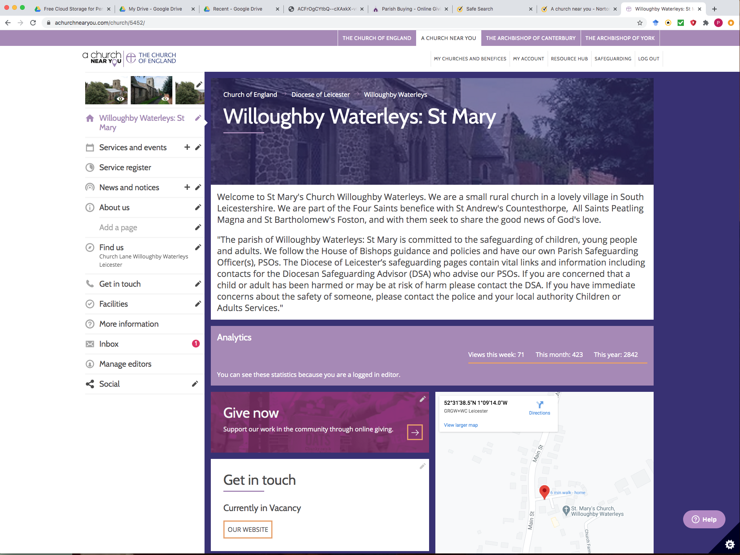
Online Giving
https://www.achurchnearyou.com/church/5452/
Notes:
https://www.achurchnearyou.com/church/5452/

Slide 15
How to set up Online Giving
Parish Buying Account
SumUp / Give a Little Account
Create a campaign
Insert button onto website or A Church Near You
Promote
Notes:
Need a PB account
Need a Sumup account, which will include inputting your banking details –
need to make sure that when this is inputted it is checked by another person (this can be done online during lockdown).
Create a campaign (can be multiple if you have special appeals etc)
Show Phil’s A Church Near You page.
Promote – perhaps with some Christmas Fundraising activity?

Slide 16
Any questions?
Online Giving
Notes:
Plug national guides and sessions
Offer a session from Phil to take them through step by step

Slide 17
When the event has finished
Don’t forget to thank people for their part in the event, tell them how it went, how much was raised and how you have spent the money
Notes:
We may not realise that any barriers are there when it comes to giving.
By information I mean both information about the current financial situation and also information about how to give. This feels harder in times when we’re not using the building, and it means we have to do things a little differently.
Helping people to give in a way that works for them, whilst also thinking about what technical tools and solutions we need for a time like this, and to prepare us for the cashless future that I’ve talked about.

Slide 18
The three keys to fundraising success!
1st - Choose a simple fundraising idea that suits your community
2nd – Set up an online giving page
3rd - Promote your event and your online giving page!

Slide 19
Finally…..
Please contact the Generous Giving Team
If you would like any help
If you have any concerns generally about giving to your church
If you would like to know more about any aspect of digital giving
Generous Giving Team Contact details:
generousgiving@leccofe.org
Sally Bossingham Philip Leech Rachel Broughton
07950 428829 07535 144416 rachel.broughton@leicestercofe.org

