Slide 1
Eco Church
Akeley East Deanery
18 Feb 2020

Slide 2

Creating a culture of creation care
Diocesan Overview – Jane Woolmer
Rural Lens – Lauretta Wilson and Keith
Eco Church- Marie Birkinshaw
Workshop

Slide 3

Eco Diocese
Leading from the front

Slide 4
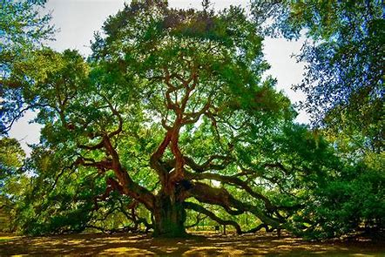
Through the Rural Lens
A gentle start, a series of Eco evenings
  Raise the profile of the Environment within the benefice
  Promote sustainable living
  Local recycling events

Slide 5
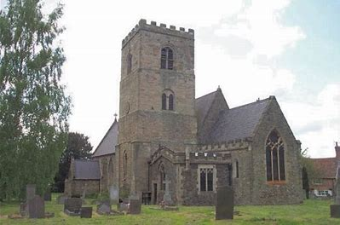
Through the Rural Lens
A series of events at All Saints, Long Whatton
Clothes Swaps
Produce Swaps
Plastic Free Period Products

Slide 6







www.ecochurch.arocha.org.uk
A Rocha – Christian Conservation Charity – Eco Church
Eco Church begins in the PCC
To strive to safeguard the integrity of creation and sustain and renew life on earth
a vital part of Christian discipleship

Slide 7
www.ecochurch.arocha.org.uk
Create a network of local centres of creation care in the community
A small group of enthusiastic people
Engaged clergy and staff team
Support of the PCC and Treasury Committee
Create a Culture of Creation Care

Slide 8

Eco Deanery Workshop
Creating a culture of creation care
Split into 4 groups
What are the Environmental Initiatives in your church?
Which 3 are the most inspiring - report

Slide 9
3 Most Inspiring Initiatives in Your Church
Light bulbs changed to LED
Encouraging people to recycle at church like they do at home
Aspiring to have solar panels
Knit squares to make blankets
Talking about our electricity bills can we go green at church and at home
Grow, cook, share - people sharing their produce
Jumble sales
Using recycled wooden kitchen to turn into a new vestry
Upgrading the boiler
Engaging people with what they can do at home
Working with local primary school on the same theme
Efficient heating system on for the minimum length of time
Encouraging the use of chicken wire in flower festival instead of oasis
Use of compost bin at church
Knitting of scarfs and hats for the homeless
Eco products for cleaning products
Thinking about fair trade food and drink
Putting nest boxes in church towers
Reducing printing by putting newsletters on line
Using fans on high ceilings to bring heating down
Underfloor heating
Using the churchyard to plant fruit trees and rhurbarb
Signing up to be an eco church
Making reuseable sanitary products
Recycling candles by making our own from left overs
Using Ecover products

Slide 10
Eco Deanery Workshop
Creating a culture of creation care
In your groups:
Make a list of the most important things we must do to embark on the journey to create an Eco Church?

Slide 11
Important Things We Must Do TO
Point 1
Point 2

